Slide 1
Unit 2
Architecting and Designing Enterprise Applications

Slide 2
Architecture
Architecting and Designing are the foundation for successful enterprise application
The master blueprint of the application is termed as architecture
ANSI/IEEE Std 1471 defines architecture as “the fundamental organization of a system embodied in its components, their relationships to each other and to the environment and the principles guiding its design and evolution”
Architecture is a collection of related components or structure that coexists in a given context for a purpose
Architecture serves as Blueprint for guiding the design of an application

Slide 3
Views and Viewpoints
Architecture description is organized in the form of “views” and “viewpoints”
Viewpoints is the stakeholders view of the enterprise application
View is how the enterprise application looks like from a selected viewpoint
For example use cases in the use case diagram are considered as viewpoints
Each view is represented as one or more appropriate models using languages like UML

Slide 4
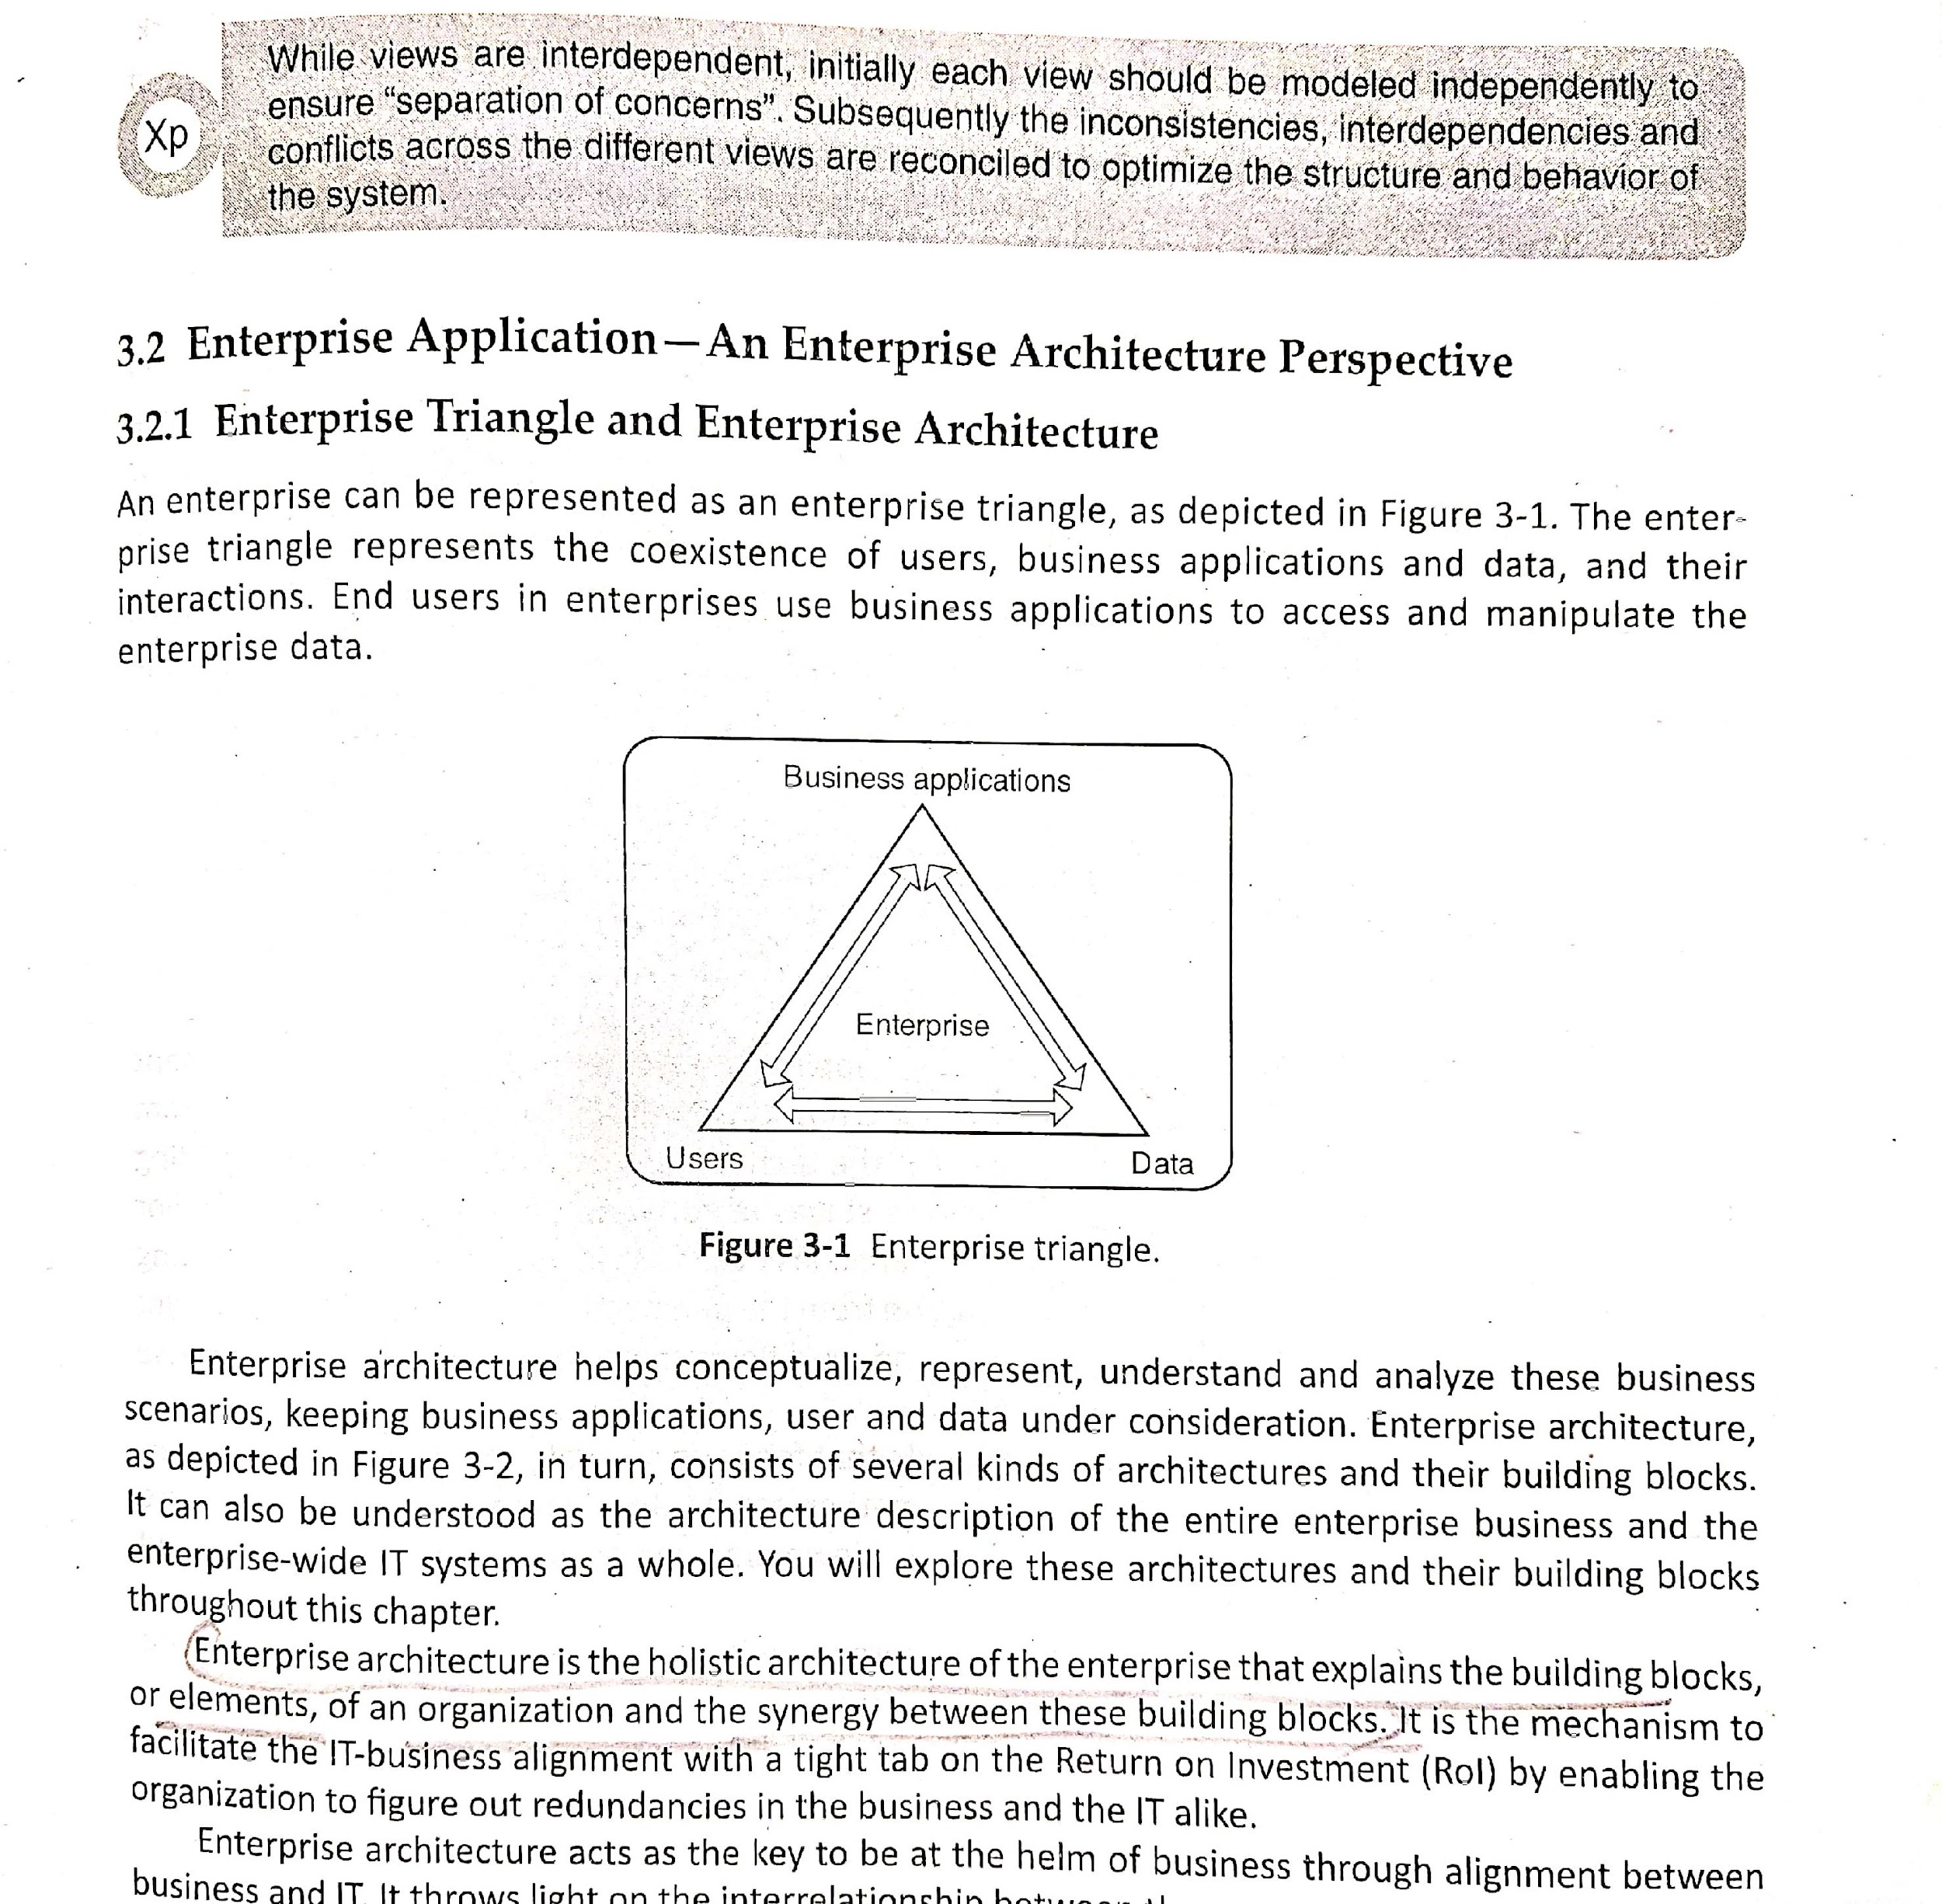
Enterprise Architecture
An Enterprise Application consists of data, users and business applications which interact with each other.
An enterprise can be represented as enterprise triangle that represent the coexistence of users, business applications and data their interactions
Enterprise Triangle

Slide 5
Enterprise Architecture (contd..)
Enterprise architecture helps to conceptualize, represent, understand and analyze these business scenarios, keeping business applications, user and data under consideration.
Enterprise architecture is shown in the next slide
Enterprise architecture in turn contains several architectures
Enterprise architecture is the one that explains the building blocks of an organization and the interaction between these building blocks
It helps in alignment between business and IT

Slide 6
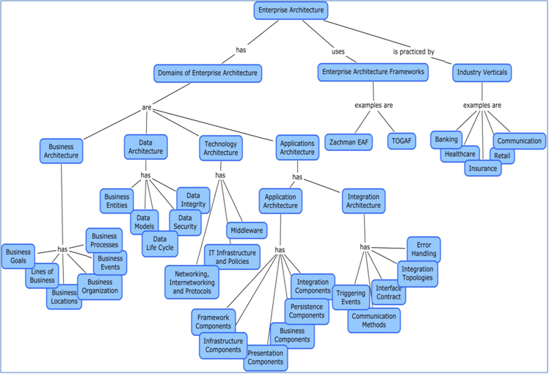
Enterprise Architecture (contd..)

Slide 7
Enterprise Architecture (contd..)
Enterprise Architecture Framework
An enterprise architecture framework specifies a set of views and viewpoints and comprises of principles, standards, guidelines, approaches, services, design concepts and models to facilitate the development of enterprise architecture.
TOGAF( The Open Group Architecture Framework) is one of the most popular enterprise architecture framework.
TOGAF defines 4 sub-architectures or domains of enterprise architectures
(refer the diagram in previous slide)
1. Business architecture
2. Data architecture
3. Applications architecture
4. Technology architecture

Slide 8
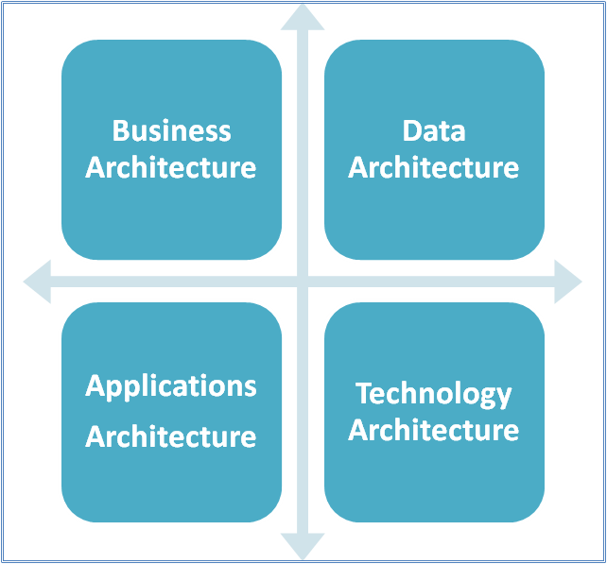
Enterprise Architecture (contd..)
4 sub-architectures or domains of TOGAF

Slide 9
Enterprise Architecture (contd..)
TOGAF Architecture Domains
Business architecture: focuses on the overall strategy and governance of the business processes and other key elements of the business such as business goals, lines of business, business locations, business organization, business events and business process.
Applications architecture: is the structure of interconnection and interactions of all the applications in an enterprise and maps to the underlying enterprise business processes.
Data architecture: focuses on the overall data assets – both logical and physical that an organization possesses. It defines how the data is being organized in the application, Data models, data life cycle management and security of data. Data architecture is sometimes referred to as information architecture

Slide 10
Enterprise Architecture (contd..)
TOGAF Architecture Domains
4. Technology architecture: consists of building blocks which include the middleware components used to glue the applications, IT infrastructure hardware and software and networking and communication protocols.

Slide 11
Enterprise Architecture (contd..)
Other popular enterprise architecture frameworks
1.Zachman Enterprise Architecture framework
2. EAF from Gartner
3. C4ISR for Department of Defense, USA

Slide 12
Enterprise Architecture (contd..)
Blueprint of an Enterprise Application
Enterprise Architecture is the blueprint of the enterprise application
Enterprise architecture helps understanding how an application fits within the existing enterprise landscape, and guides arriving at the blueprint of an application.
The blueprint of an enterprise application consists of the following architectures:
Logical architecture
Technical architecture
Data architecture
Infrastructure architecture

Slide 13
Enterprise Architecture (contd..)
Blueprint of an Enterprise Application
Logical architecture
Functionality of an application can be mapped to a set of logical building blocks
Logical architecture serves as the blueprint to the architects to arrive at an optimal enterprise application solution
2. Technical architecture
Technical architecture serves as the starting point for the implementation and consists of application frameworks, design patterns, APIs and programming languages
Primary goal of technical architecture is to provide simple, maintainable and robust design building blocks that can be easily extendable

Slide 14
Enterprise Architecture (contd..)
Blueprint of an Enterprise Application
3. Data architecture
Data architecture primarily focused on identifying, modeling and defining data that needs to be processed by the enterprise application
4. Infrastructure architecture
Infrastructure architecture describes the physical hardware, supporting systems software required for deployment of enterprise application
It identifies types of servers like database servers, physical location of deployment, backup plan, storage, middleware requirements etc

Slide 15
Logical Architecture
Elements of business architecture define the functionality of a given enterprise application.
This functionality can be mapped to a set of logical building blocks which implement the enterprise application.
These logical building blocks together define the logical architecture of an enterprise application.
The logical architecture serves as the blueprint to the architects to arrive at an optimal enterprise application solution.
Logical architecture is the bridge between requirements captured and Implementation

Slide 16
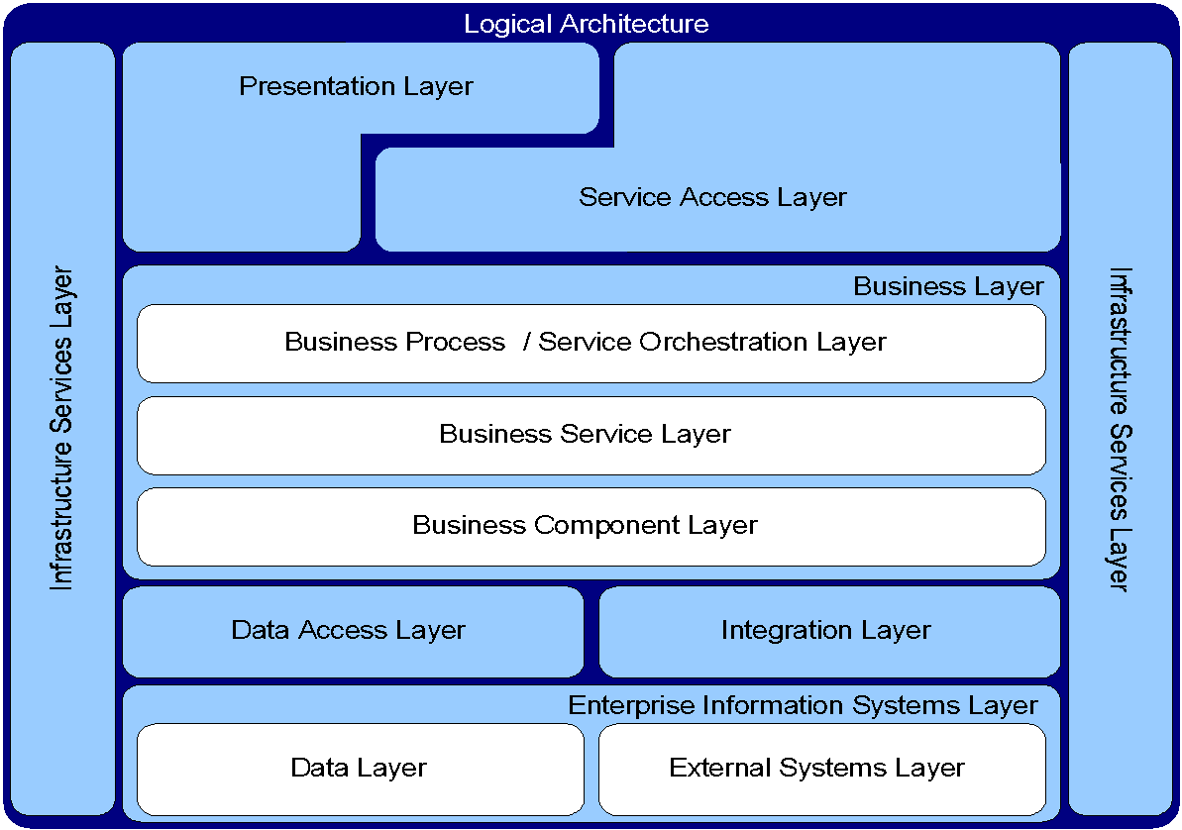
Logical Architecture (contd..)

Slide 17
Logical Architecture (contd..)
The logical architecture have the seven following layers: (see previous slide)
1. Presentation layer
2. Service access layer
3. Business layer
4. Data Access layer
5. Integration layer
6. Enterprise information systems layer
7. Infrastructure services layer

Slide 18
Logical Architecture (contd..)
Layers of Logical Architecture
Business Layer
It is the core layer of the enterprise application
Business layer can be considered to comprise of three sub layers to represent business processes, business services and business components.
Business Process Layer: represents the business processes implemented in the application.
Business Services Layer: Business processes, in turn, are composed from one or more business services and are represented in the Business Service Layer.
Business Component Layer: represents the lowest level of abstraction of business layer in terms of underlying business entities.

Slide 19
Logical Architecture (contd..)
Layers of Logical Architecture
2. Enterprise Information Systems (EIS) Layer
Enterprise Information Systems layer consists of the following 2 layers
Data Layer
Enterprise application has to connect with database or other storage mechanism which is represented as Data layer
External Systems Layer
Enterprise application may require data from external applications which is represented as External systems layer

Slide 20
Logical Architecture (contd..)
Layers of Logical Architecture
3, 4. Data Access Layer and Integration Layer
These two layers hide the physical details of storage and access mechanisms from the business layer
5. Presentation Layer
Used by the human users to access the services of enterprise application
6. Service Access Layer
Used by the external systems to access the services of enterprise application
7. Infrastructure Services Layer
This layer provides the reusable and general purpose components like logging, caching, auditing etc

Slide 21
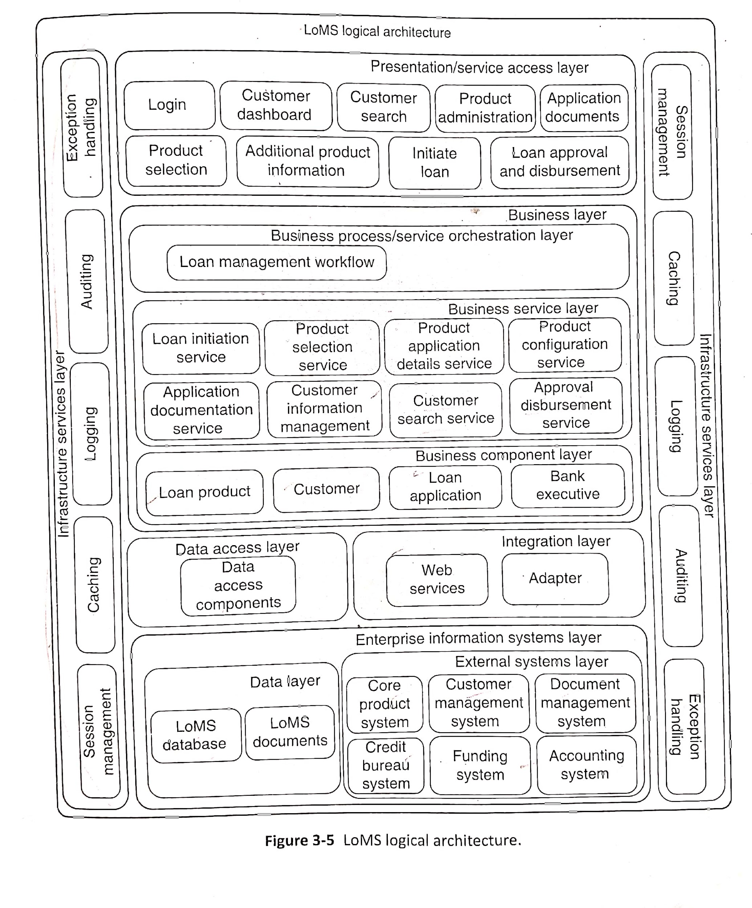
Logical Architecture of LoMS (Loan Management System)

Slide 22
Technical Architecture
Technical architecture translates the logical architecture into a technical solution which comprises of chosen technologies, APIs and frameworks
Technical architecture is derived from the logical architecture by adding technology components into the individual layers
Software architecture patterns are used in the technical architecture. These patterns are acts as reference points
One example of the software architecture pattern is the Layered Architecture pattern

Slide 23
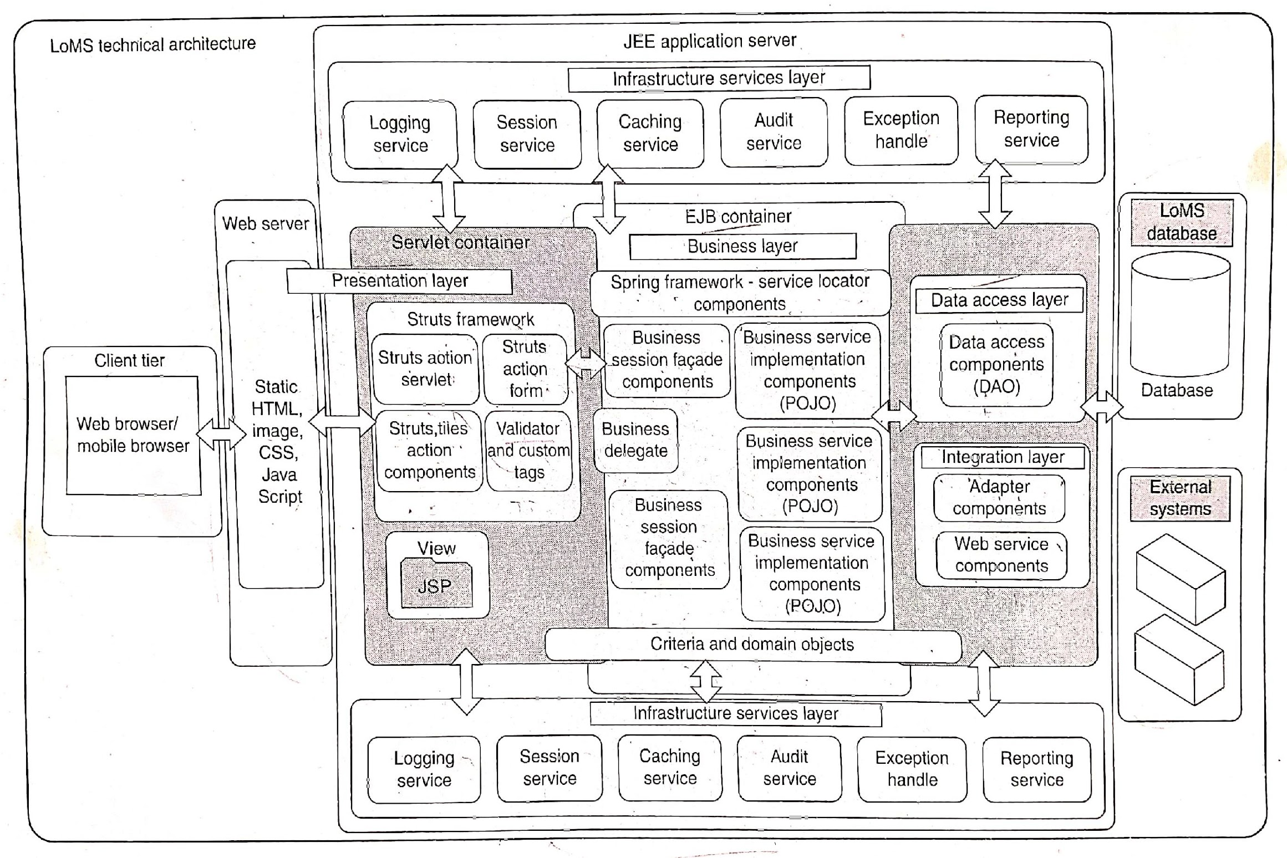
Technical Architecture of LoMS

Slide 24
Technical Architecture (contd..)
Object Oriented Analysis and Design
Object Oriented Analysis and Design (OOAD) technique used during the architecture and design phase helps model the software entities
To implement the technical solution, Object-oriented programming(OOP)is used during the construction phase
Objects and Classes
Identification of objects and classes is the first step in OOAD
Object is the real world entity
Classes is the collection of objects

Slide 25
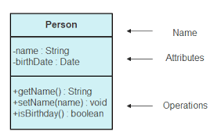
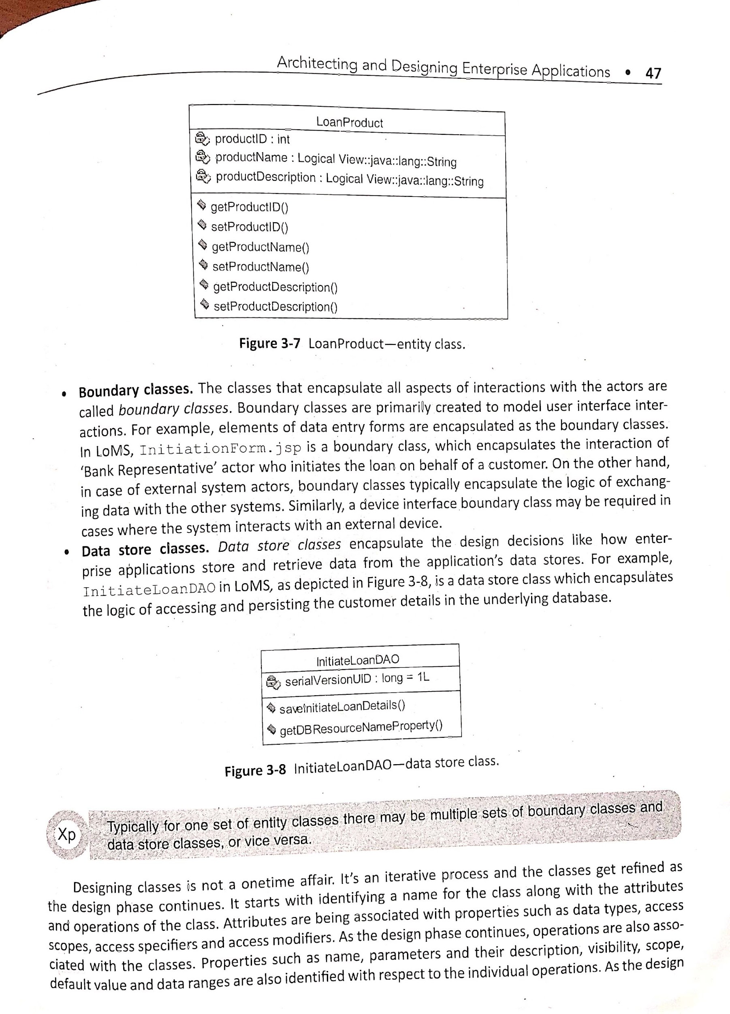
Technical Architecture (contd..)
By considering the use cases documented in the inception phase, the following classes are identified:
Entity classes
The classes that contains the core business entities are called as Entity classes
Each class is represented as rectangle that has 3 sections
1st section: class name
2nd section: attributes (characteristics)
3rd section: methods (behavior)
Above 2 diagrams shows for Person and LoanProduct classes
`1

Slide 26
Technical Architecture (contd..)
2. Boundary classes
The classes that encapsulates all aspects of interactions with the actors are called Boundary classes
These classes are used to model interface interactions
Example: Elements in data entry forms are the boundary classes
3. Data store classes
Theses classes show how the enterprise applications store and retrieve data from the applications' data store
InitiateLoanDAO encapsulates the logic of accessing and persisting the customer details in the database

Slide 27
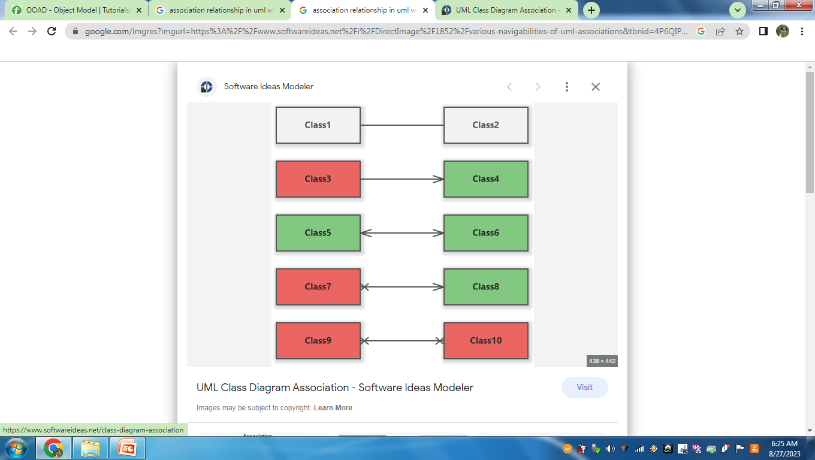
Technical Architecture (contd..)
Relationships among classes
Association
Generalization
1. Association
Relationship that exists between the classes
It is represented by a line between the classes
If two classes are involved in the relationship then it is called as Binary Association

Slide 28
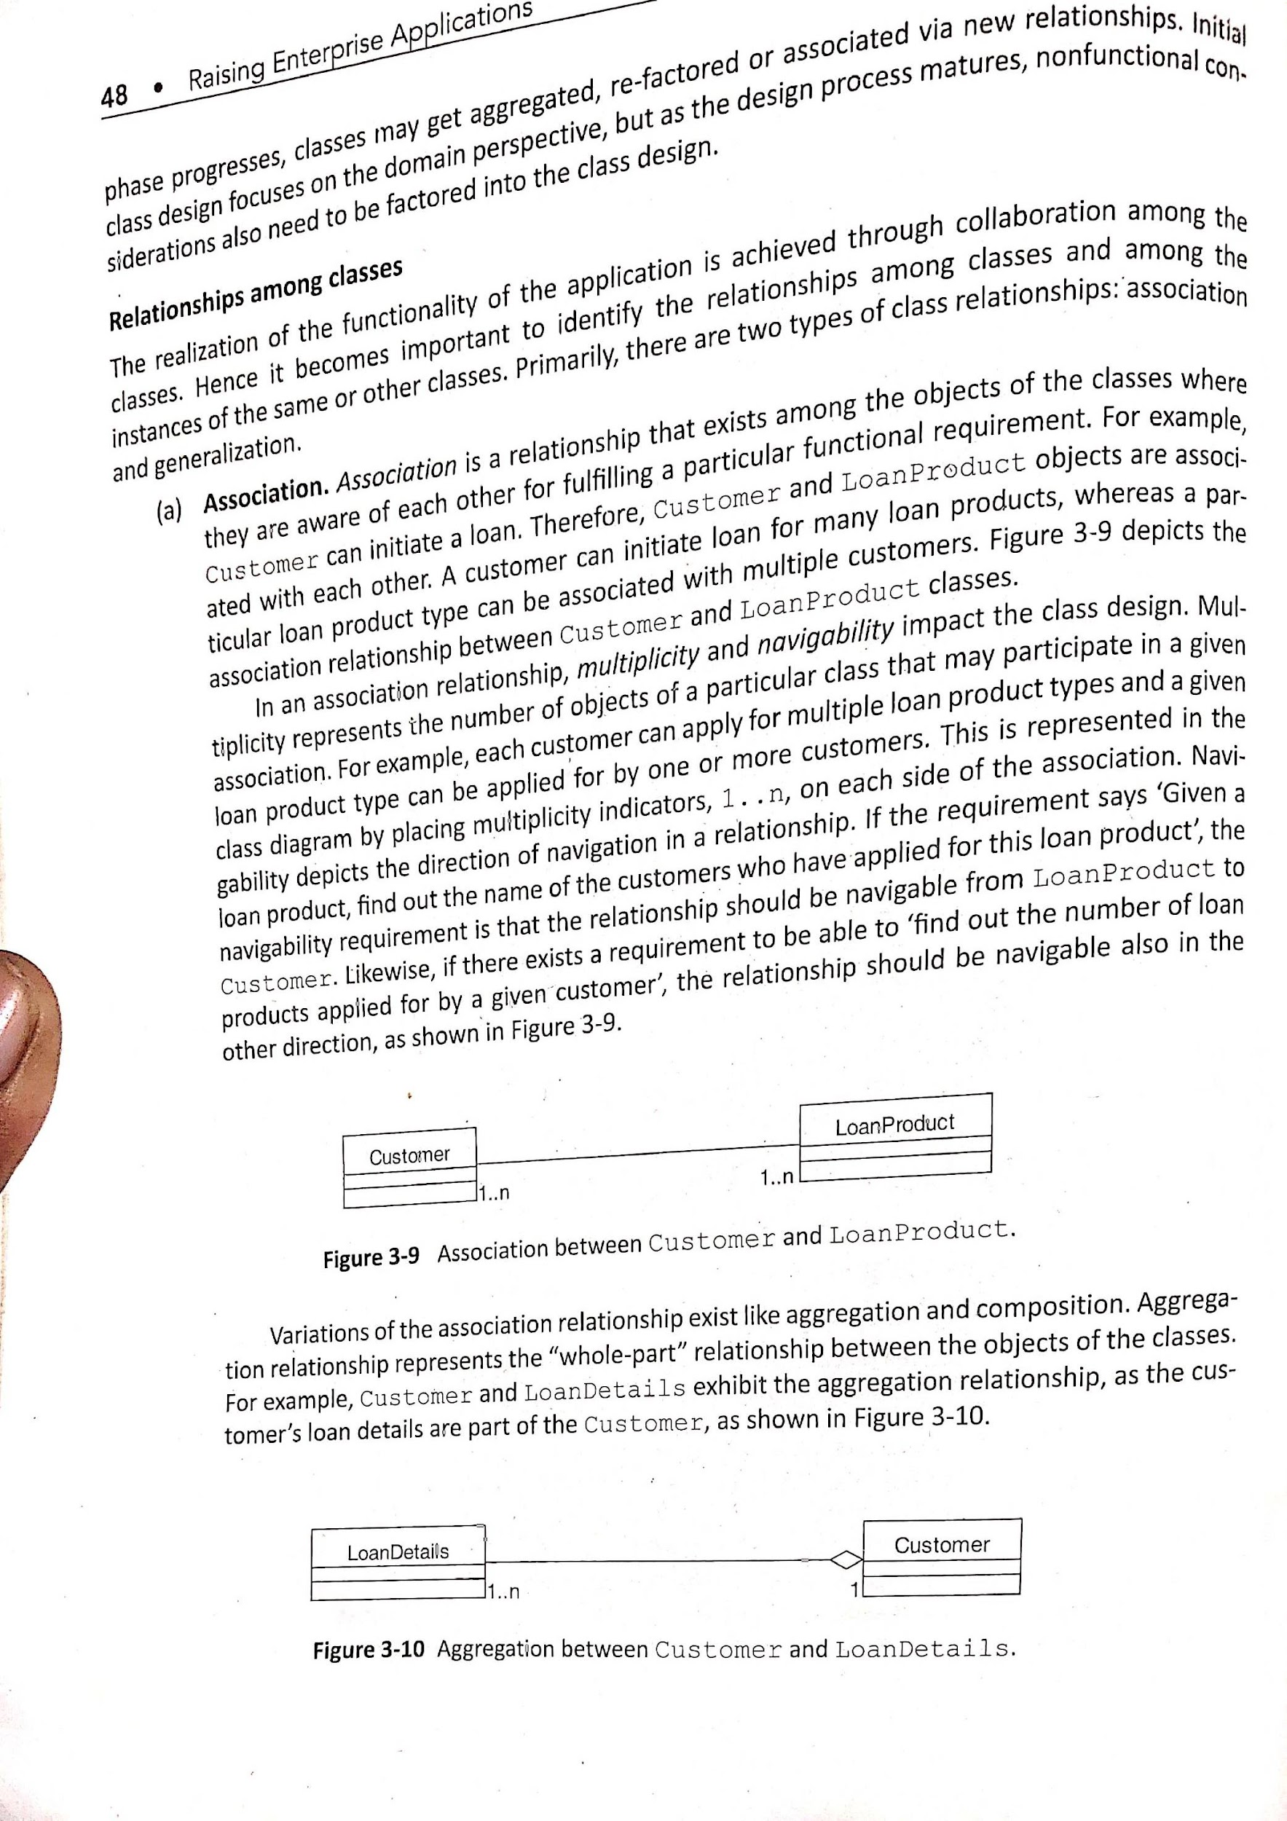
Technical Architecture (contd..)
Association cardinality
Cardinality of a binary association denotes the number of objects of a class participating in an association. Cardinality is also called as Multiplicity
There are three types of cardinality , namely
1. One–to–One − A single object of class A is associated with a single object of class B.
2. One–to–Many − A single object of class A is associated with many objects of class B.
3. Many–to–Many − An object of class A may be associated with many objects of class B and conversely an object of class B may be associated with many objects of class A.
given association
In above diagram single customer can have one or more loans similarly single loan may be applied by one or more customers. Above diagram is an example of Many-to-Many mapping

Slide 29
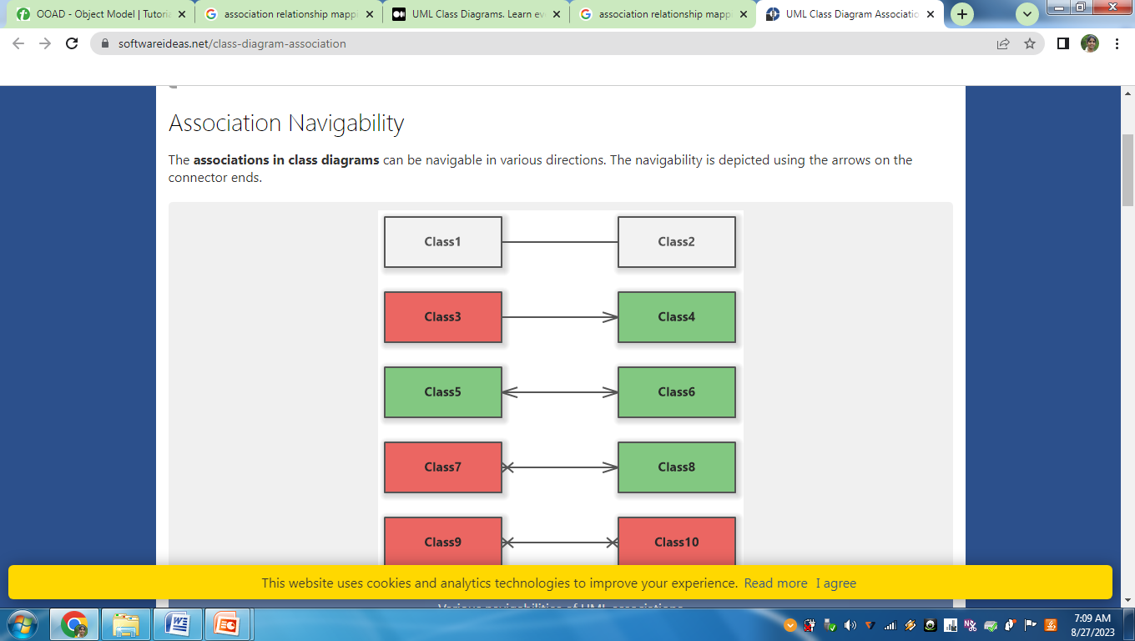
Technical Architecture (contd..)
Association Navigability:
says about the direction of navigation in a relationship. Relationship should be navigable
1. Navigable in one direction - the association can be navigated from Class3 to Class4, but not from Class4 to Class3
2. Navigable in both directions - the association can be navigated from Class5 to Class6 and also from Class6 to Class5

Slide 30
Technical Architecture (contd..)
Variations of Association relationship
1. Aggregation
2. Composition

Slide 31
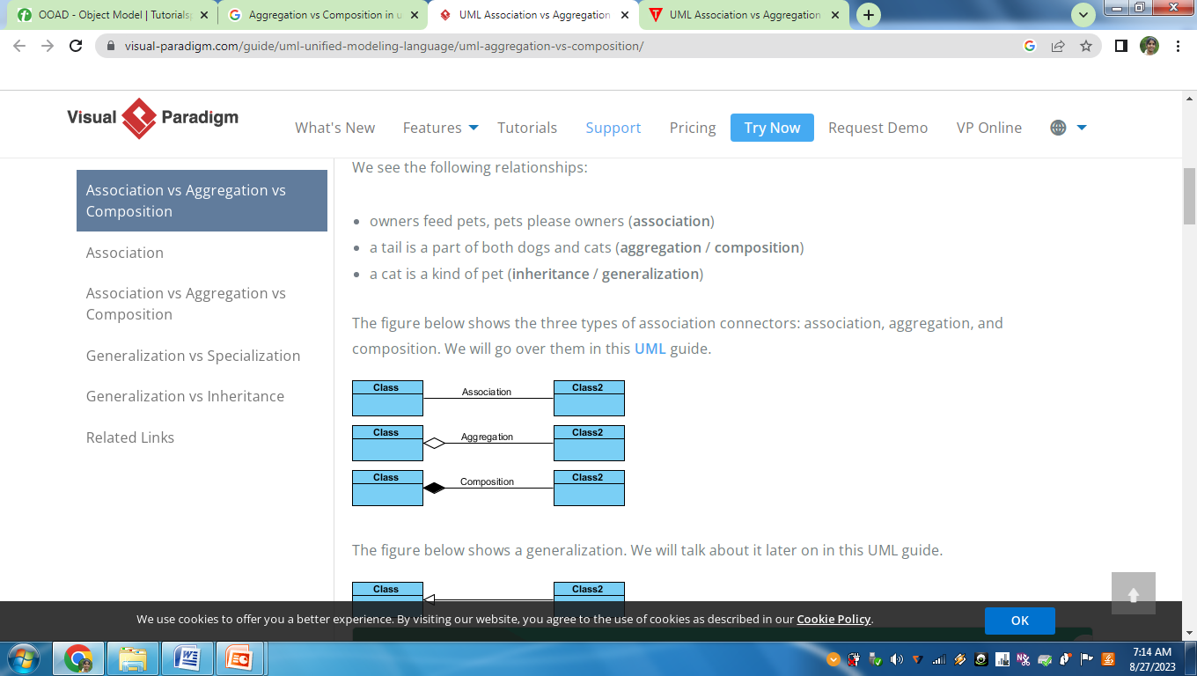
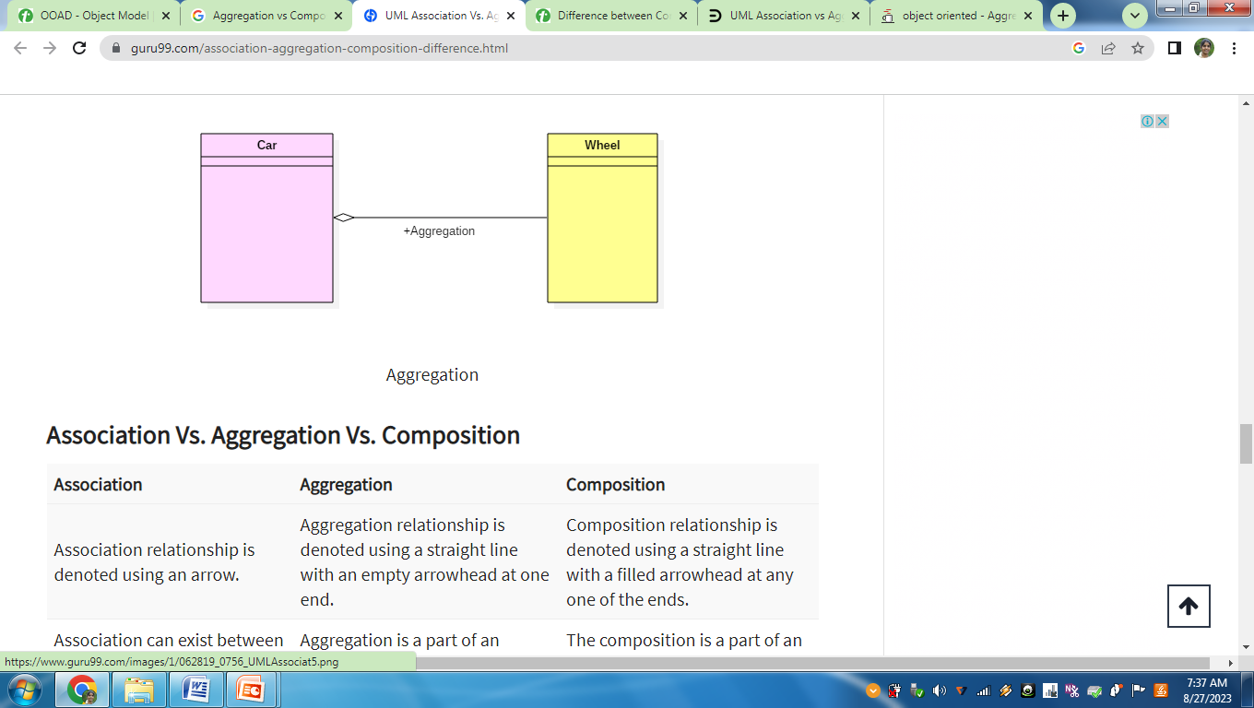
Technical Architecture (contd..)
1. Aggregation
It is a kind of relationship in which the child class exist independently of the parent class
“has-a” relationship between the objects of the classes
Aggregation relationship is represented by a straight line with an empty diamond at one end (parent class end)
Example
Car needs wheel to function correctly. But wheel does not always needs a car. It can be used with other vehicles like bike, bicycle

Slide 32
Technical Architecture (contd..)
Aggregation
Example
Customer may contain loan details. But LoanDetails class exist independently of the customer class

Slide 33
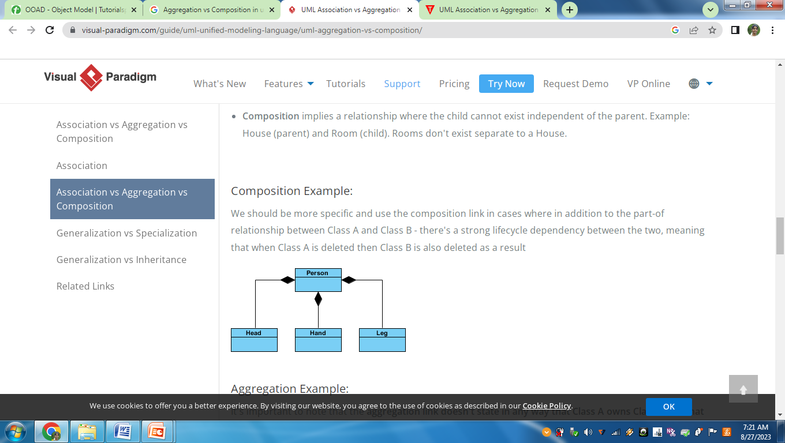
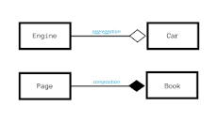
Technical Architecture (contd..)
2. Composition
In a composition relationship, the child class cannot exist independently without parent class. If parent class is deleted child class is also deleted
“part-of” relationship between classes
The composition relationship is represented by a straight line with a black diamond at one end(parent class end)
Example
Without book there is no page and without person there is no head ,hand and leg

Slide 34
Technical Architecture (contd..)
Difference between Aggregation and Composition
Aggregation | Composition
It is a kind of relationship in which the child class exist independently of the parent class | In a composition relationship, the child class cannot exist independently without parent class.
It represents “has-a” relationship | It represents “part-of” relationship
It is represented by a straight line with an empty diamond at one end | It is represented by a straight line with a black diamond at one end
Deleting parent class does not affect child class | If parent class is deleted child class is also deleted
Example | Example

Slide 35
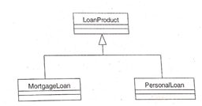
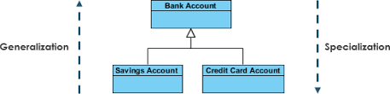
Technical Architecture (contd..)
2. Generalization
If a class is a generalized form of one or more classes it is represented by generalized relationship
Represents “is a” or “kind of” relationship among classes
Also called as Inheritance
Example

Slide 36
Technical Architecture (contd..)
UML Diagrams
1. Class diagrams
To represent a partial view of the system
Model the static aspects of the application
2. Sequence diagrams
To visualize the sequence of actions
To convey the sequence of message passing or method calls among classes in a given use case
To capture the dynamic view
3.Collaboration diagrams
Depicts how classes collaborate rather than the sequence of actions
4. State chart diagram
To model various states that a particular object may go through during the execution of the application

Slide 37
Technical Architecture (contd..)
Infrastructure Services Layer
Infrastructure services layer is the layer that provides the common services for all the other layers in an enterprise application so that all the designers and developers can use it in a uniform manner.
This layer is also known as common services layer.

Slide 38
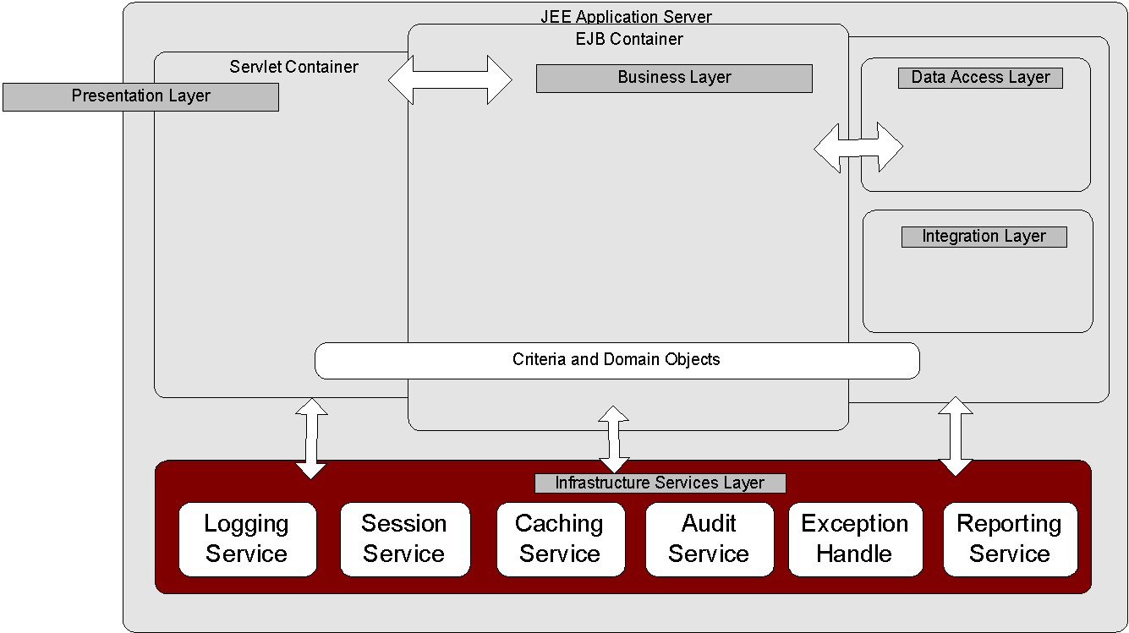
Technical Architecture (contd..)
Infrastructure Services Layer

Slide 39
Technical Architecture (contd..)
Infrastructure Services Layer
1. Logging
Need for auditing and debugging purposes
To keep track of usage of various resources by the users of an enterprise application
Eg: InitiateLoan use case logs events like getting the preapproved loan amount based on SSN, or saving the loan details after validation.
LoMs uses Log4J as underlying logging mechanism

Slide 40
Technical Architecture (contd..)
Infrastructure Services Layer
2. Caching
Technique for improving the performance of an application
It involves bringing frequently used data to the high speed primary memory from the secondary store where it is persisted so that the application can readily access it.
Approaches
1. Pre-fetch
Pre-fetch the data at application startup and store it in the cache
2. Lazy loading
The data is retrieved from the data source at the time of the first request, and thereafter the data may remain stored in the cache
In LoMS, Jboss caching is used

Slide 41
Technical Architecture (contd..)
Infrastructure Services Layer
3. Security
AAA security requirements
Authentication
Authorization
Auditing
Single sign-on (SSO) to eliminate the need for multiple authentications of the same user
In LoMS, Java Open Single Sign-On (JOSSO) is used

Slide 42
Technical Architecture (contd..)
Infrastructure Services Layer
4. Exception handling
Exceptions occur when normal flow of program instructions is disrupted due to an event
Exception handling mechanisms
User defined exceptions
Message display
Try-catch blocks
In LoMS, InitiateLoan use case should provide a strategy to handle input of an invalid SSN number of a customer

Slide 43
Technical Architecture (contd..)
Infrastructure Services Layer
5. Session management
Support for multiple concurrent users in an enterprise application
Implemented to track session using a session ID which is a unique number associated with the session
Effective session management
State management and performance
Clustering
Clustering of servers to provide redundancy for fault tolerance and load balancing
In LoMS, session data is stored in primary memory and is created for each user when the user is successfully authenticated.
It uses Jboss POJO cache solution

Slide 44
Technical Architecture (contd..)
Presentation Layer
Presentation layer is the face of the enterprise application for the user
This layer presents data and content in a user-friendly manner
This layer presents status and dynamic content to the user. Static content using HTML and dynamic content using Javascript or JSP or servlets
This layer is the bridge between user and enterprise application

Slide 45
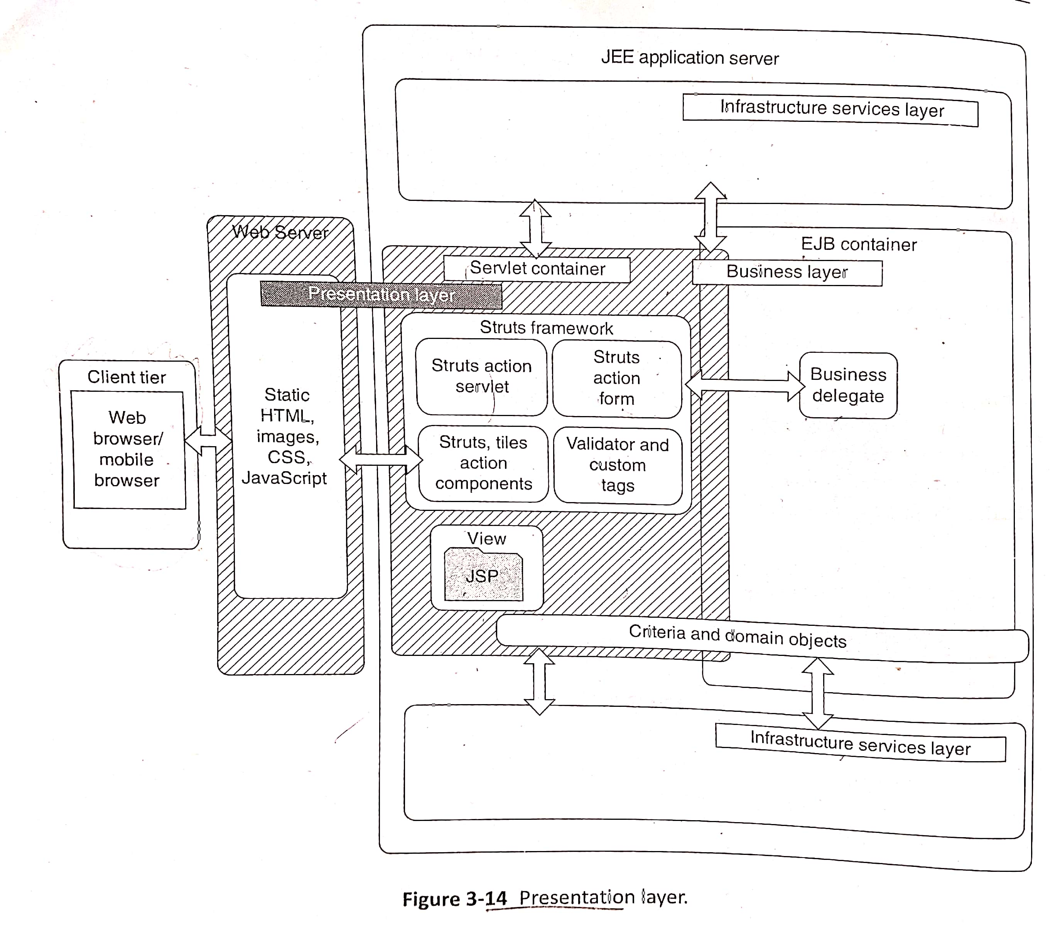
Technical Architecture (contd..)
Presentation Layer

Slide 46
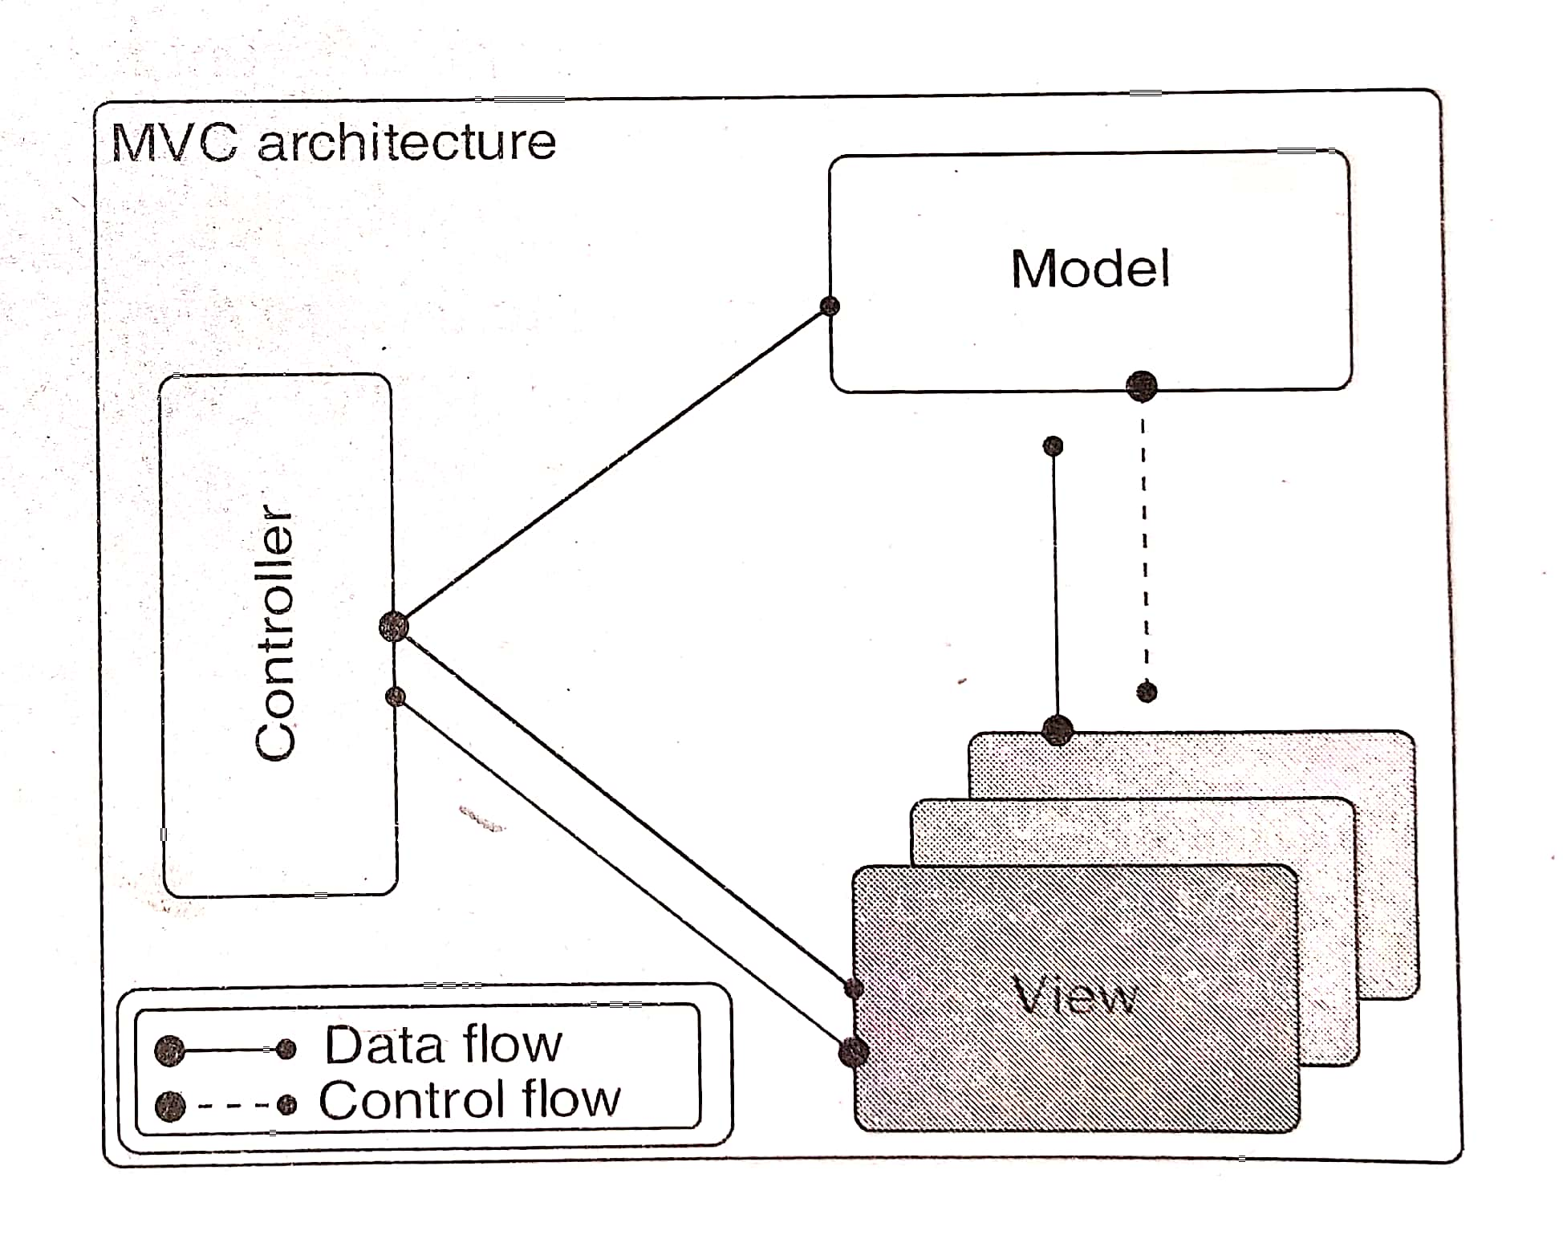
Technical Architecture (contd..)
Presentation Layer
MVC Pattern
MVC stands for Model, View and Controller
MVC pattern serves as blueprint for presentation layer
MVC pattern are used to separate the business logic(model) from the user interface(view). It allows creating new view without changing the underlying model
Interactions among model and view are controlled by “controller”

Slide 47
Technical Architecture (contd..)
Presentation Layer
Frameworks and Design Patterns
Frameworks provides a guidelines and patterns for the enterprise application
Advantage of using frameworks is that it is not necessary to build the application from scratch
JEE(Java Enterprise Edition) has several frameworks
Struts framework is suitable for the presentation layer
Whenever we are selecting a framework following parameters should be considered
1. Configurability (Easily configurable)
2. Extensibility
3. Independence

Slide 48
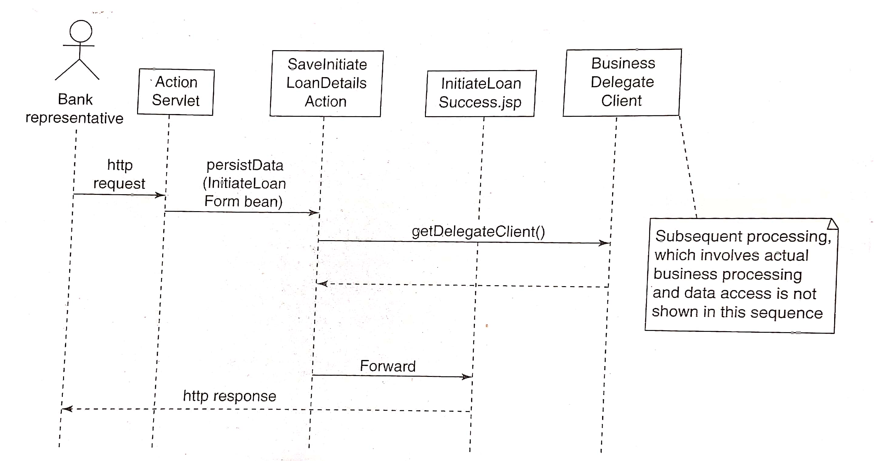
Technical Architecture (contd..)
Presentation Layer
Presentation layer Example for InitiateLoan
In below example user submits their data for loan which is verified
Once the data is verified LoanSuccess is finally sent as response to user

Slide 49
Technical Architecture (contd..)
Presentation Layer
More presentation layer technologies
Apart from JEE, other technologies like JavaScript, AJAX(Asynchronous JavaScript and XML) can be used

Slide 50
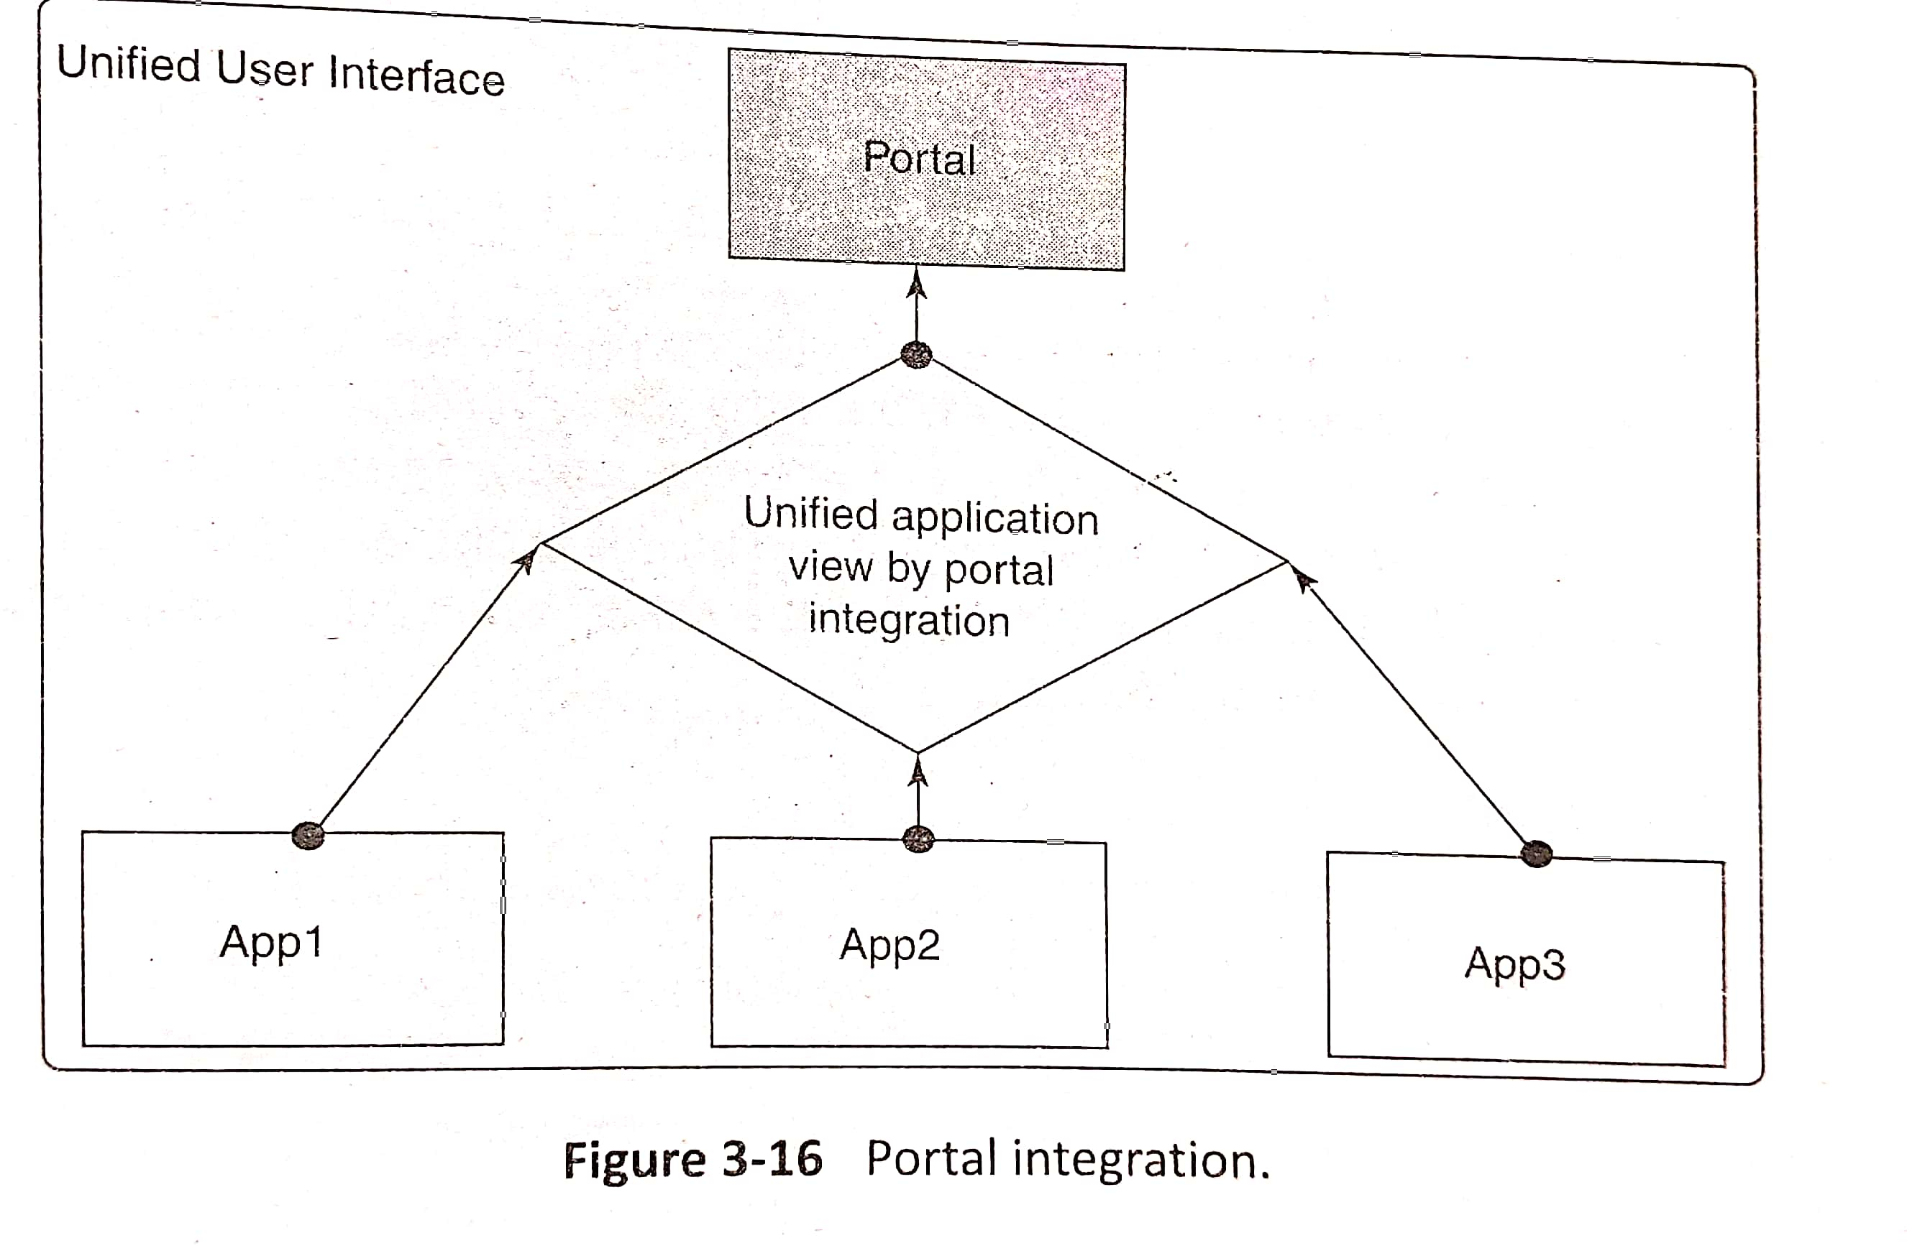
Technical Architecture (contd..)
Presentation Layer
Design aspects of Presentation layer
Usability - proper usage of screen, visual appeal
Input validation
Internationalization - Local Language support
Data Transformation
Navigation
Session management and cache management
Deployment considerations
Reusability
Security
Portal integration - Integration of several applications so that user can access the relevant application in a single window

Slide 51
Technical Architecture (contd..)
Business Layer
This layer is the heart of the enterprise application as well as the complex layer
Business layer contains business entities, business rules and business constraints
This layer is called as the middle layer of the enterprise application

Slide 52
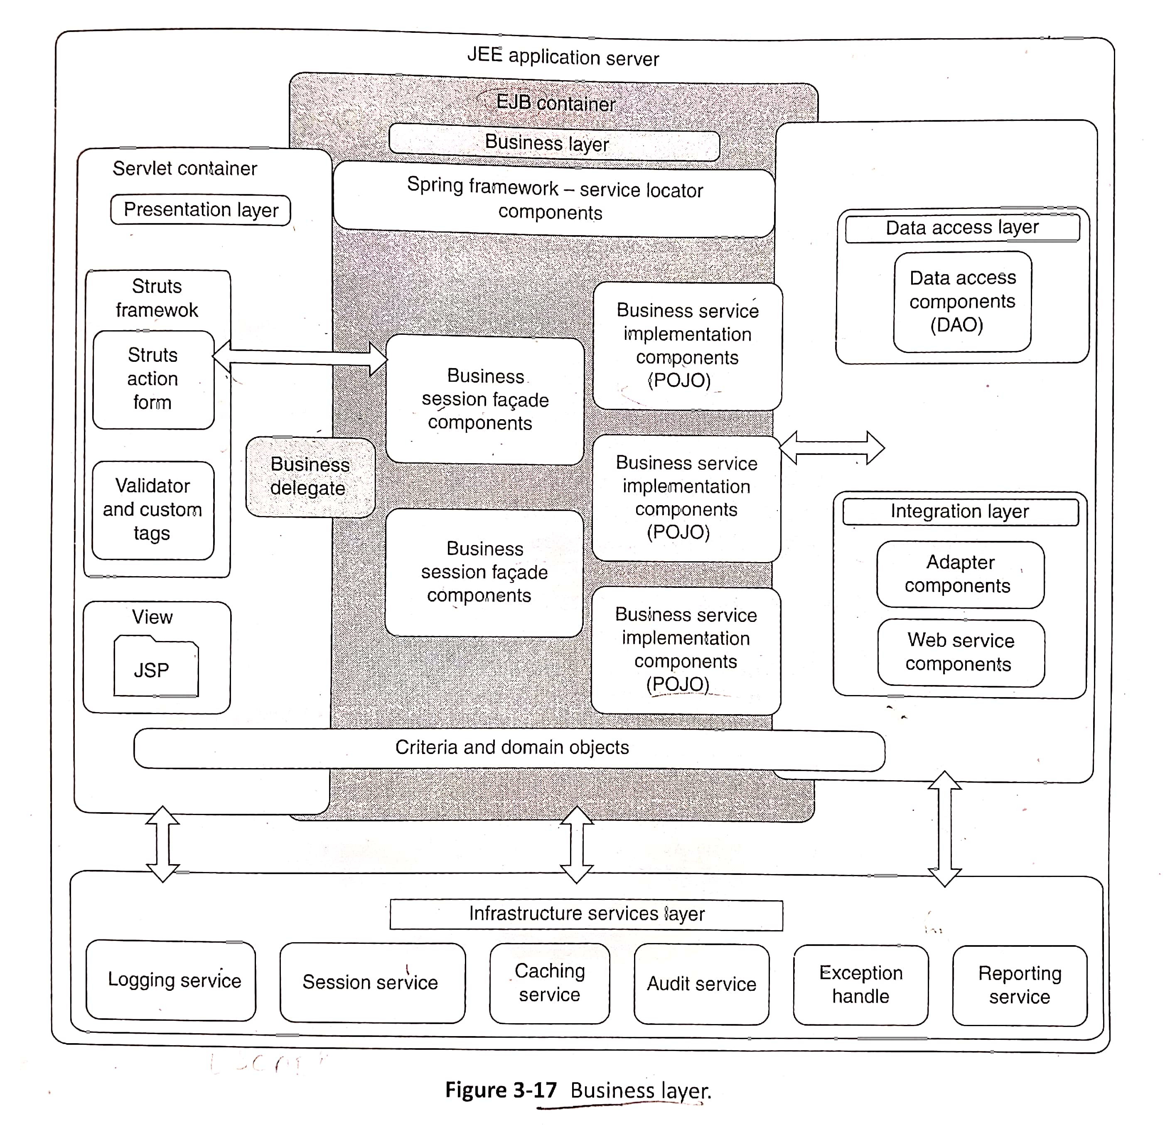
Technical Architecture (contd..)
Business Layer

Slide 53
Technical Architecture (contd..)
Business Layer
Frameworks and Design patterns
Business layer is divided into 4 components
1. Business delegate components
2. Session facade components
3. Business service components
4. Business model components
1. Business delegate components
It is the bridge between presentation and business layer
These components exposes business processes and services to the presentation layer
2. Session Facade components
These components are used for controlling the business entities by coordinating them
These components are created using enterprise session Beans(session EJBs)

Slide 54
Technical Architecture (contd..)
Business Layer
3. Business service components
It implement the business functionality of the application
It communicate with the integration layer
These components are implemented using EJBs (Enterprise Java Bean) or POJOs(Plain Old Java Object)
4. Business model components
These components comprises business data and the methods to manage the data
These components are implemented using EJBs or POJOs

Slide 55
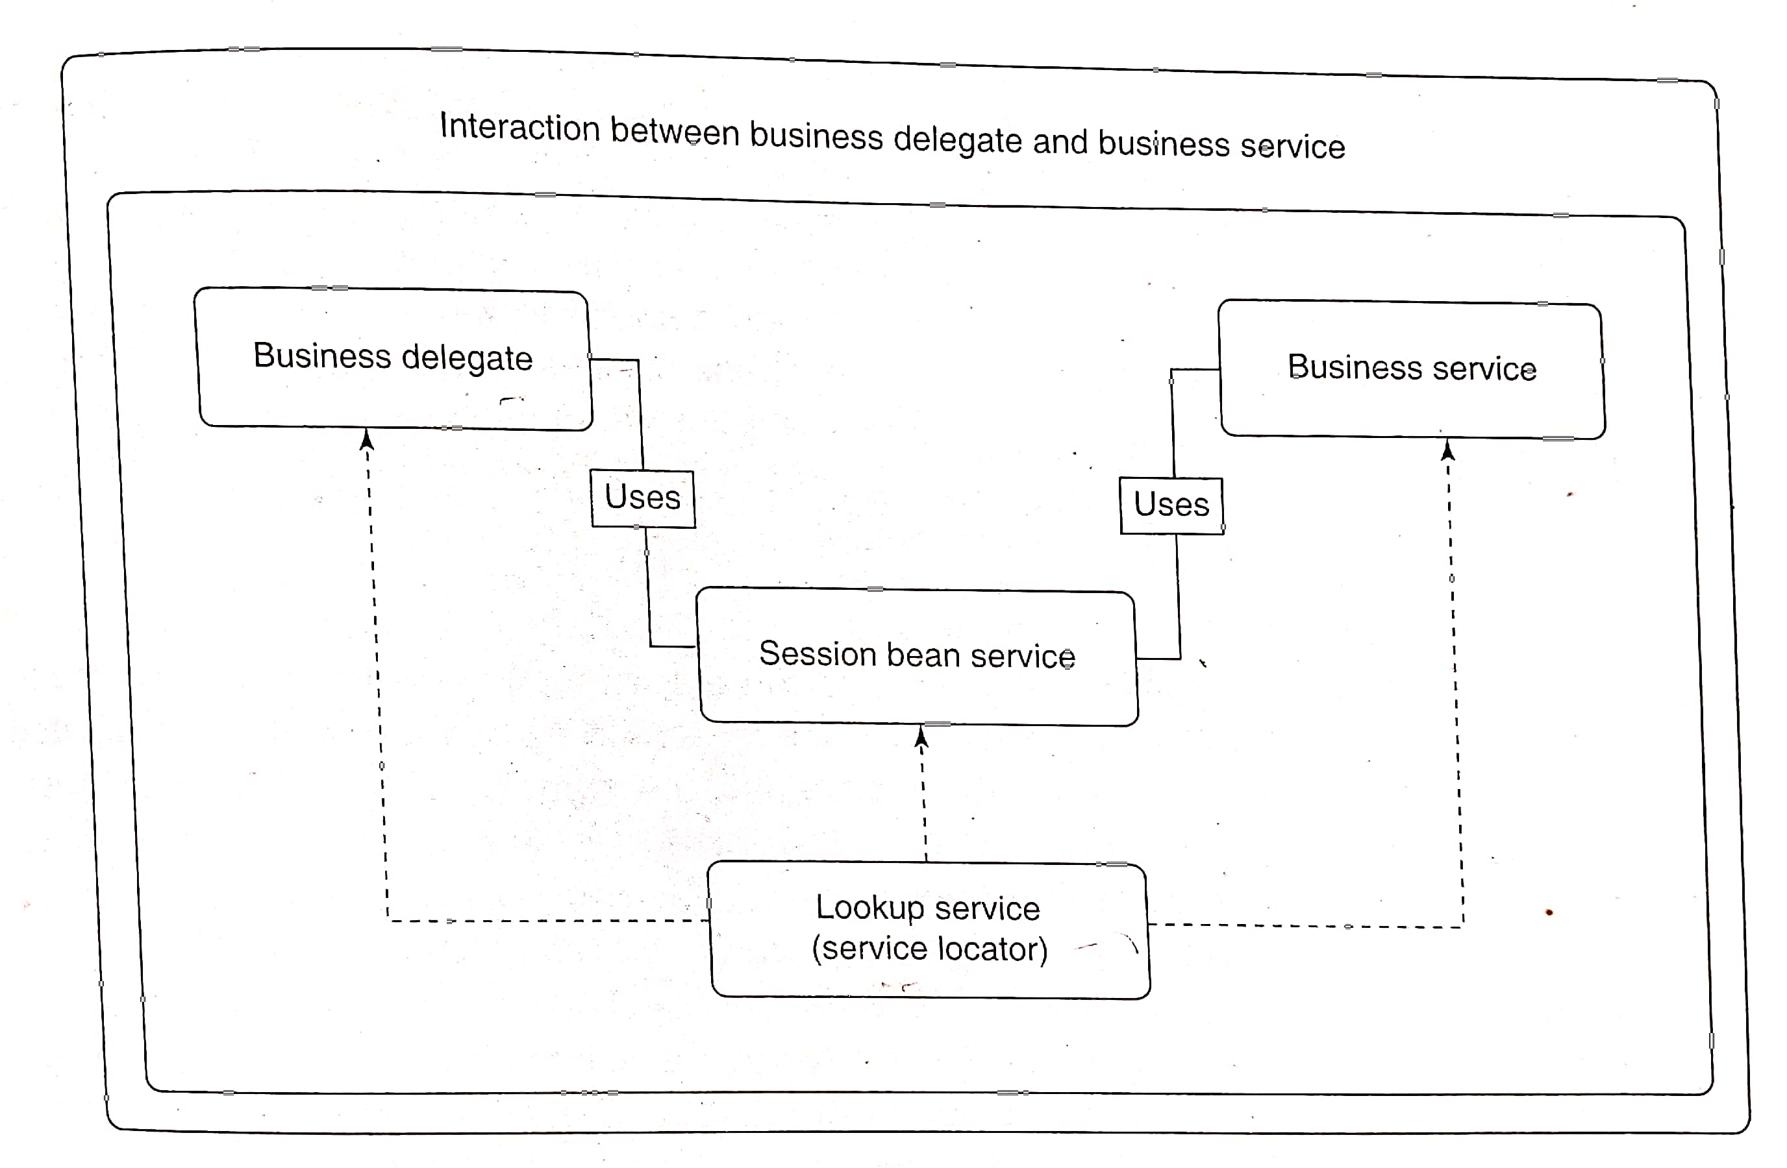
Technical Architecture (contd..)
Business Layer
Interaction between Business delegate and Business service
Business delegate components access the business service components through a lookup service
This lookup service is a Service locator
Business service components process the data and the results is given to the presentation layer by the Business delegate components

Slide 56
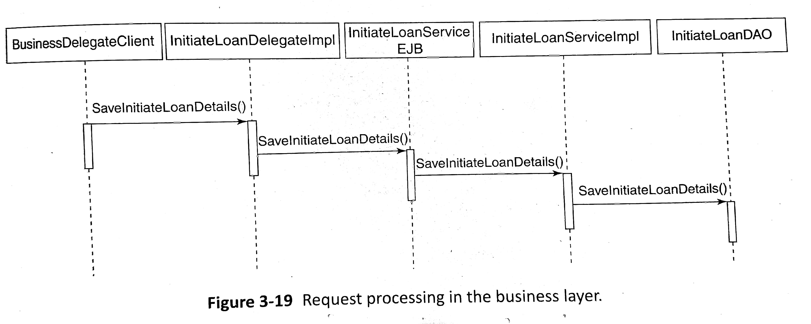
Technical Architecture (contd..)
Business Layer
Example: Initiate Loan
Below diagram shows the steps happening in the business layer for InitiateLoan
SaveInitiateLoanDetails() method first invokes the service InitiateLoanDelegate, then it invokes InitiateLoanService EJB which is a session façade which in turn invokes the service InitiateLoanServiceImpl which is the actual service implementation

Slide 57
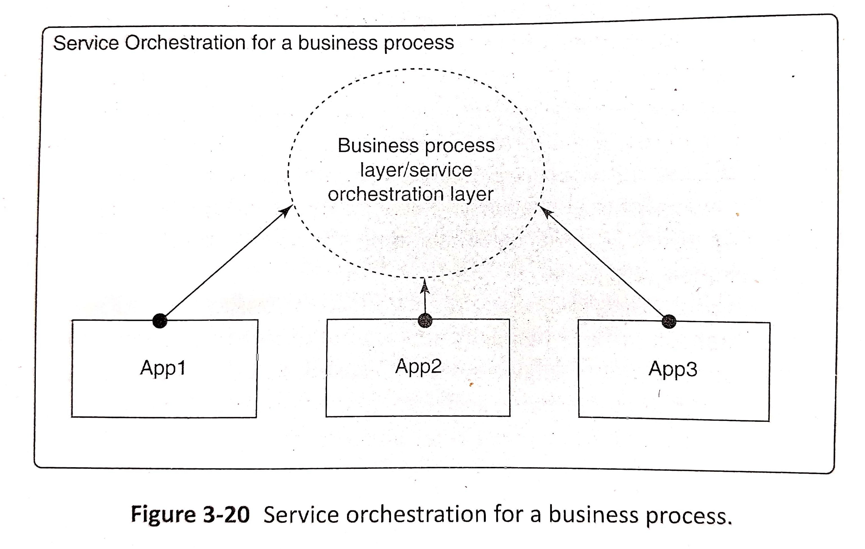
Technical Architecture (contd..)
Business Layer
Design Aspects of the Business layer
Transaction Management
- every transaction should satisfy the ACID properties
- support multiple users
2. Remote or local access of Business logic
3. Use of third-party components
- use of third party components to reduce development and testing
effort
4. External business function integration
- Several application services have to orchestrated to execute the business process

Slide 58
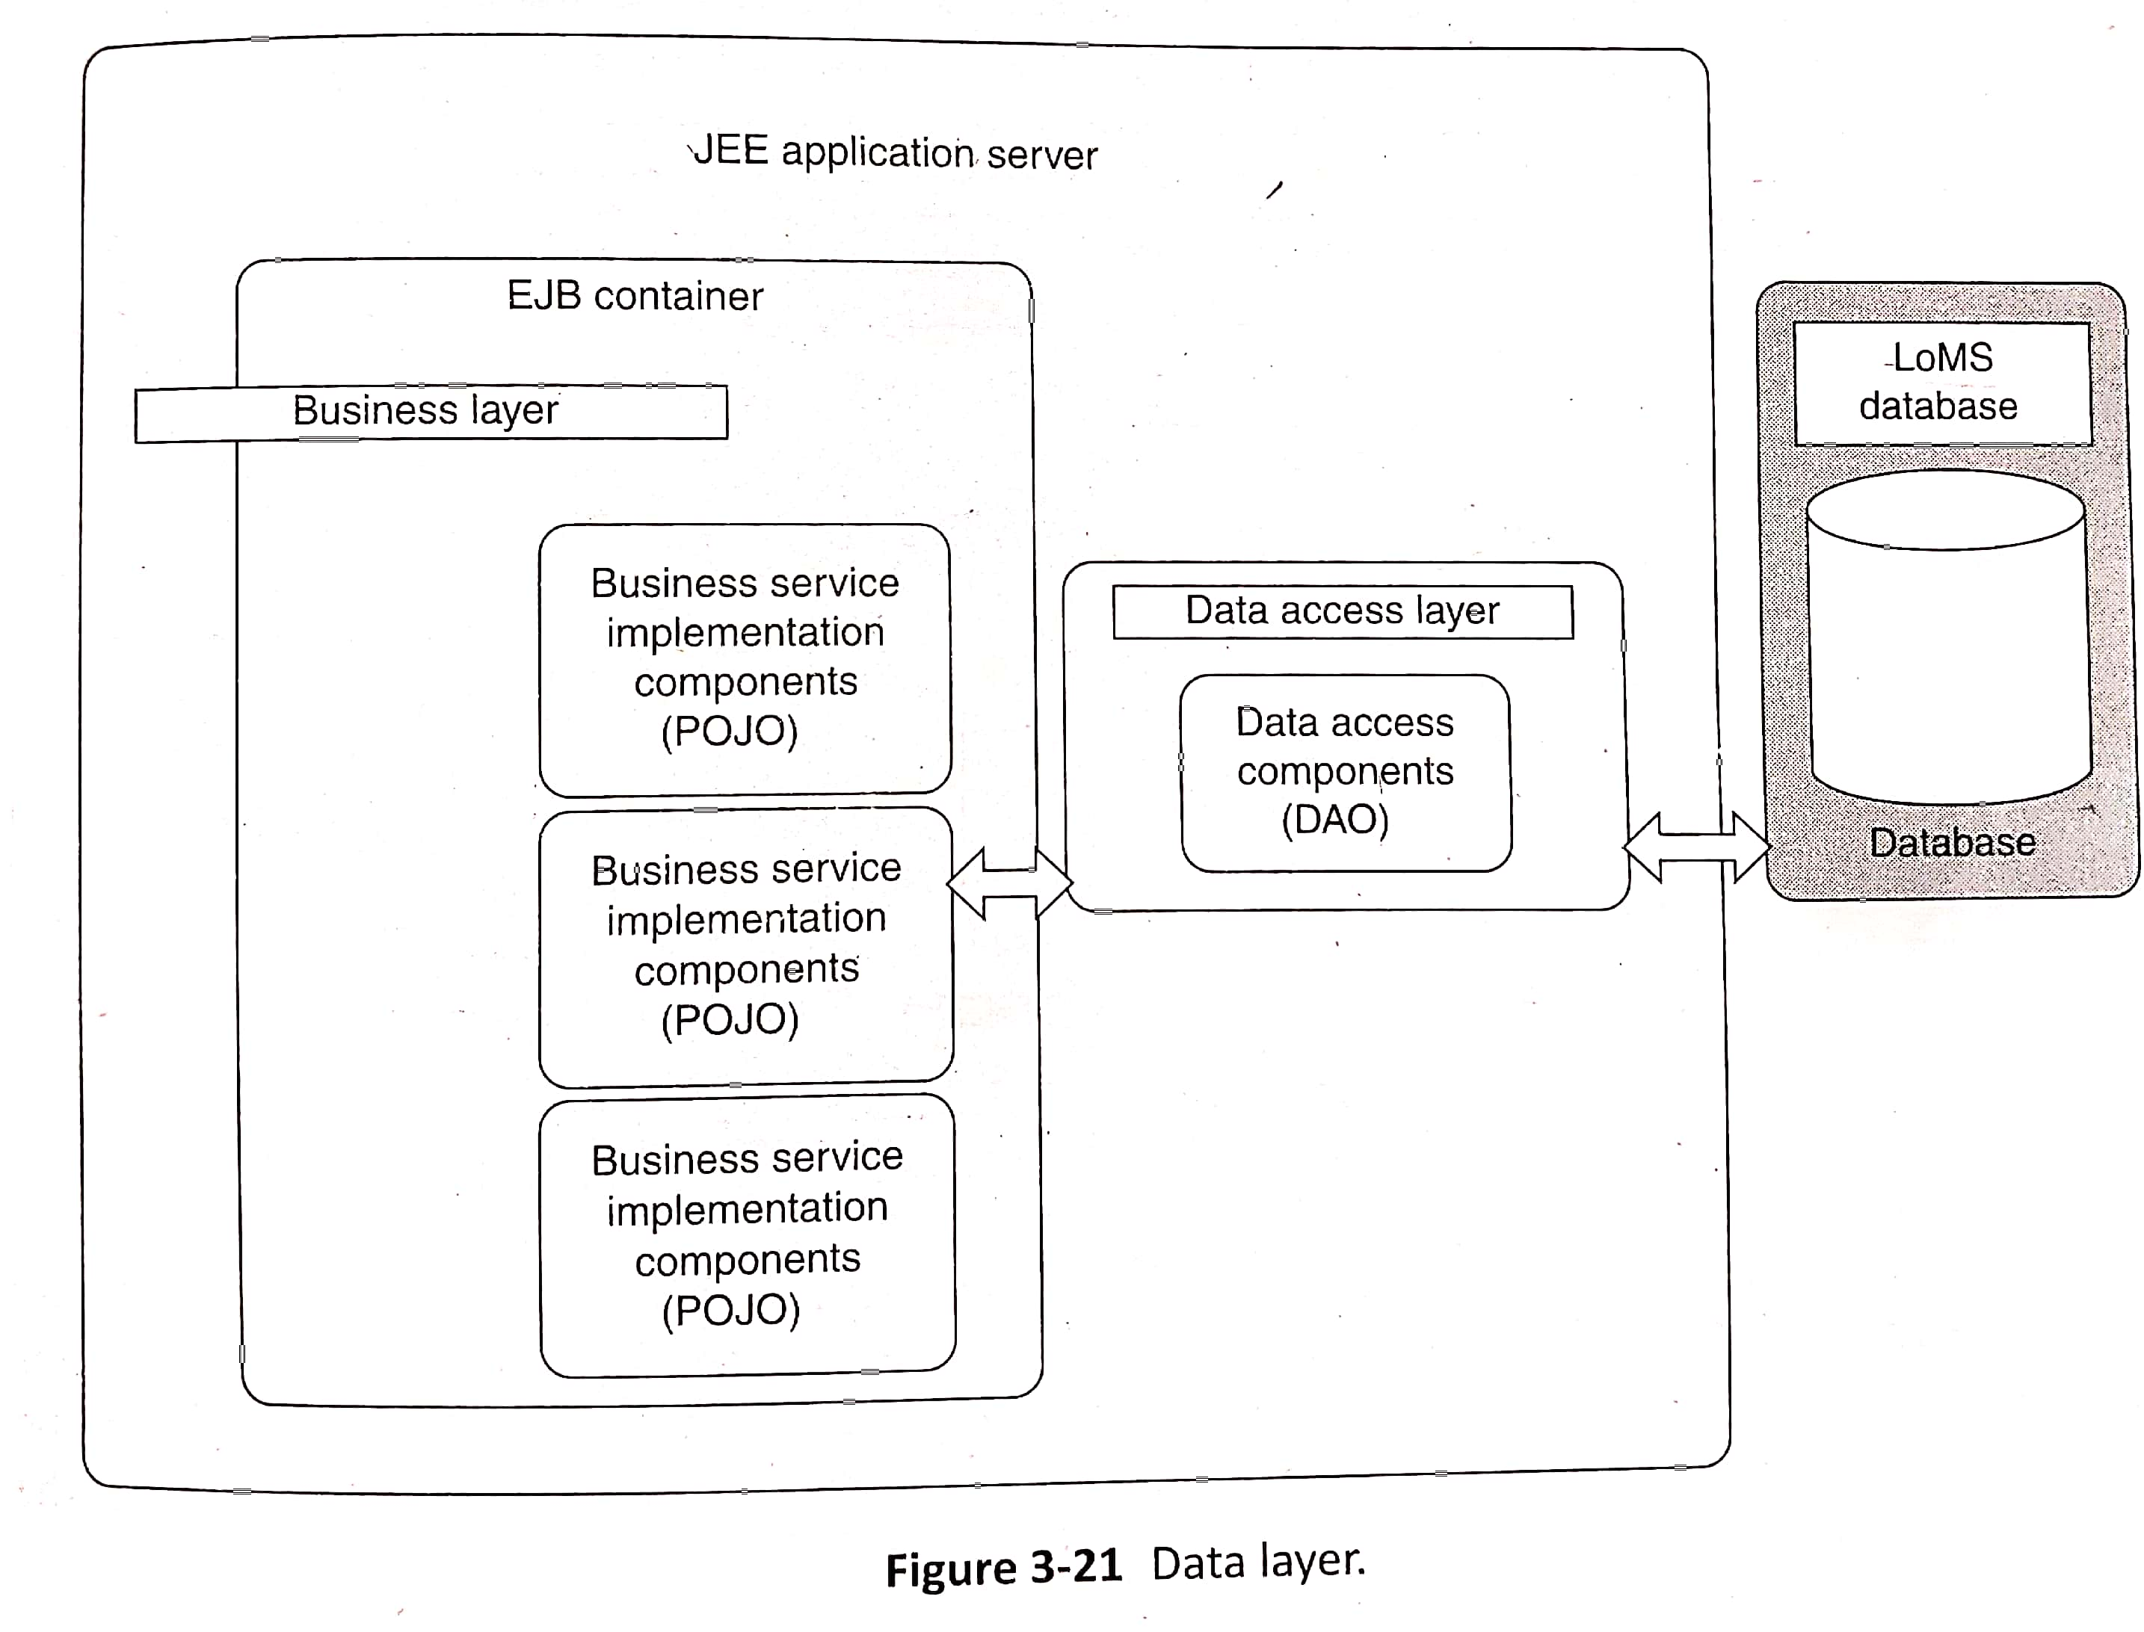
Technical Architecture (contd..)
Data Layer
Data Layer physically stores the enterprise data
This layer contains a relational database

Slide 59
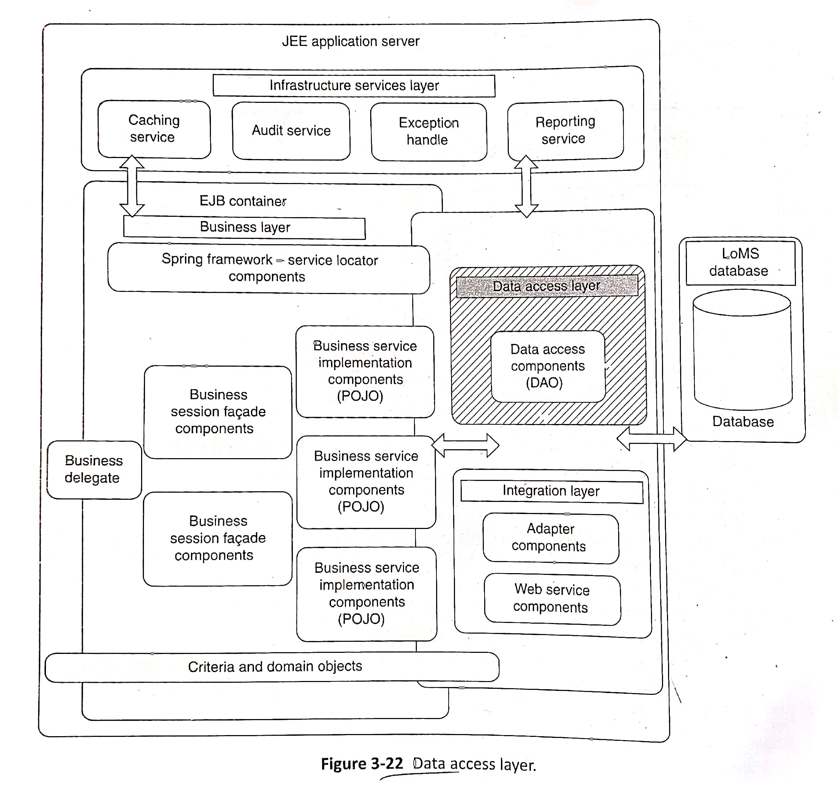
Technical Architecture (contd..)
Data Access Layer
This layer is responsible for accessing the data from the database on behalf of business layer
Technologies for Data Access layer include JDBC API, Hibernate, TopLink

Slide 60
Technical Architecture (contd..)
Data Access Layer
Frameworks and Design patterns
Data Access layer use Data Access Object(DAO) design pattern that contains details of how to access the underlying data
Mapping between Relational data and objects (Java represents data as objects) is done here

Slide 61
Technical Architecture (contd..)
Data Access Layer
Design aspects of Data Access Layer
Performance considerations
- Data access layer since it is the bridge between data layer and
business layer should be designed properly. Connection Pooling,
Query optimization and isolation level tuning techniques are used
for ensuring the performance
Object relational mapping
- Java represents data as objects and data in database is in
relational table format. Mapping should be done between this two
Handling XML data
- XML access Object(XAO) is a special case of DAO if data is in
XML format
Security considerations
- safeguard data in database from various threats

Slide 62
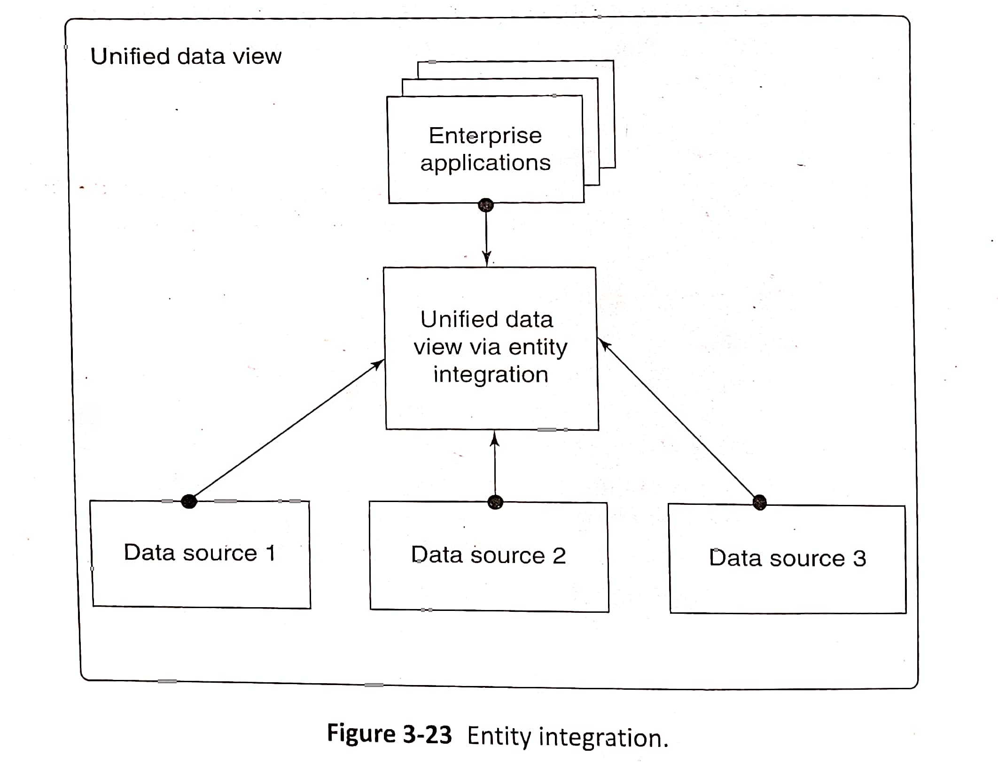
Technical Architecture (contd..)
Data Access Layer
Design aspects of Data Access Layer
Integration of distributed data
- Data from remote sources has to be integrated which is called as
entity integration

Slide 63
Technical Architecture (contd..)
External Systems Layer
This layer represents the collection of other application with which the enterprise application will interact
While other applications are interacting with the enterprise application the integration of other applications with the enterprise application has to be taken care here

Slide 64
Technical Architecture (contd..)
Integration Layer
This integration layer provides the option to connect to the external systems
This layer contains components to expose capability of the application to the outside world or compose capabilities of external system to the application
The components in this layer can be implemented using various techniques, technologies like Java based application integration, Web services etc

Slide 65
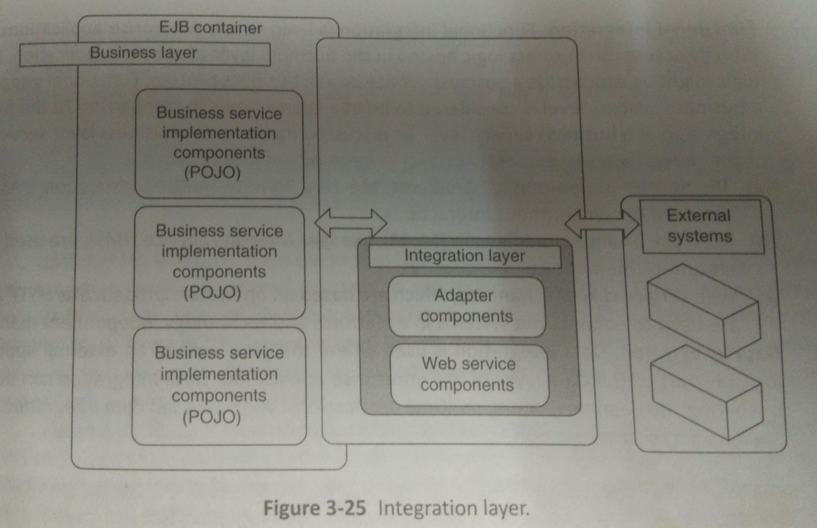
Technical Architecture (contd..)
Integration Layer

Slide 66
Technical Architecture (contd..)
Integration Layer
Integration Types
1. UI Integration
UI Integration is used when some parts of the UI of an external application has been used in the enterprise application
2. Functional Integration
This type of integration is used where enterprise application is accessing the business logic hosted in the business layer of another application
3. Data Integration
This type of integration is used when data layer of external application is part of the data layer of the enterprise application

Slide 67
Technical Architecture (contd..)
Integration Layer
Evolution of Integration Layer Technologies
Third-party EAI solutions
Vendor-specific solutions were used initially to achieve integration
Advantages of these solutions were less development effort and lower time to market
Disadvantages of these solutions were higher cost
2. Java based application integration
This integration method is used when applications that are to be integrated is built using Java platform
Java Message Services (JMS) and Java Connector Architecture (JCA) are the two APIs in JEE that support application integration

Slide 68
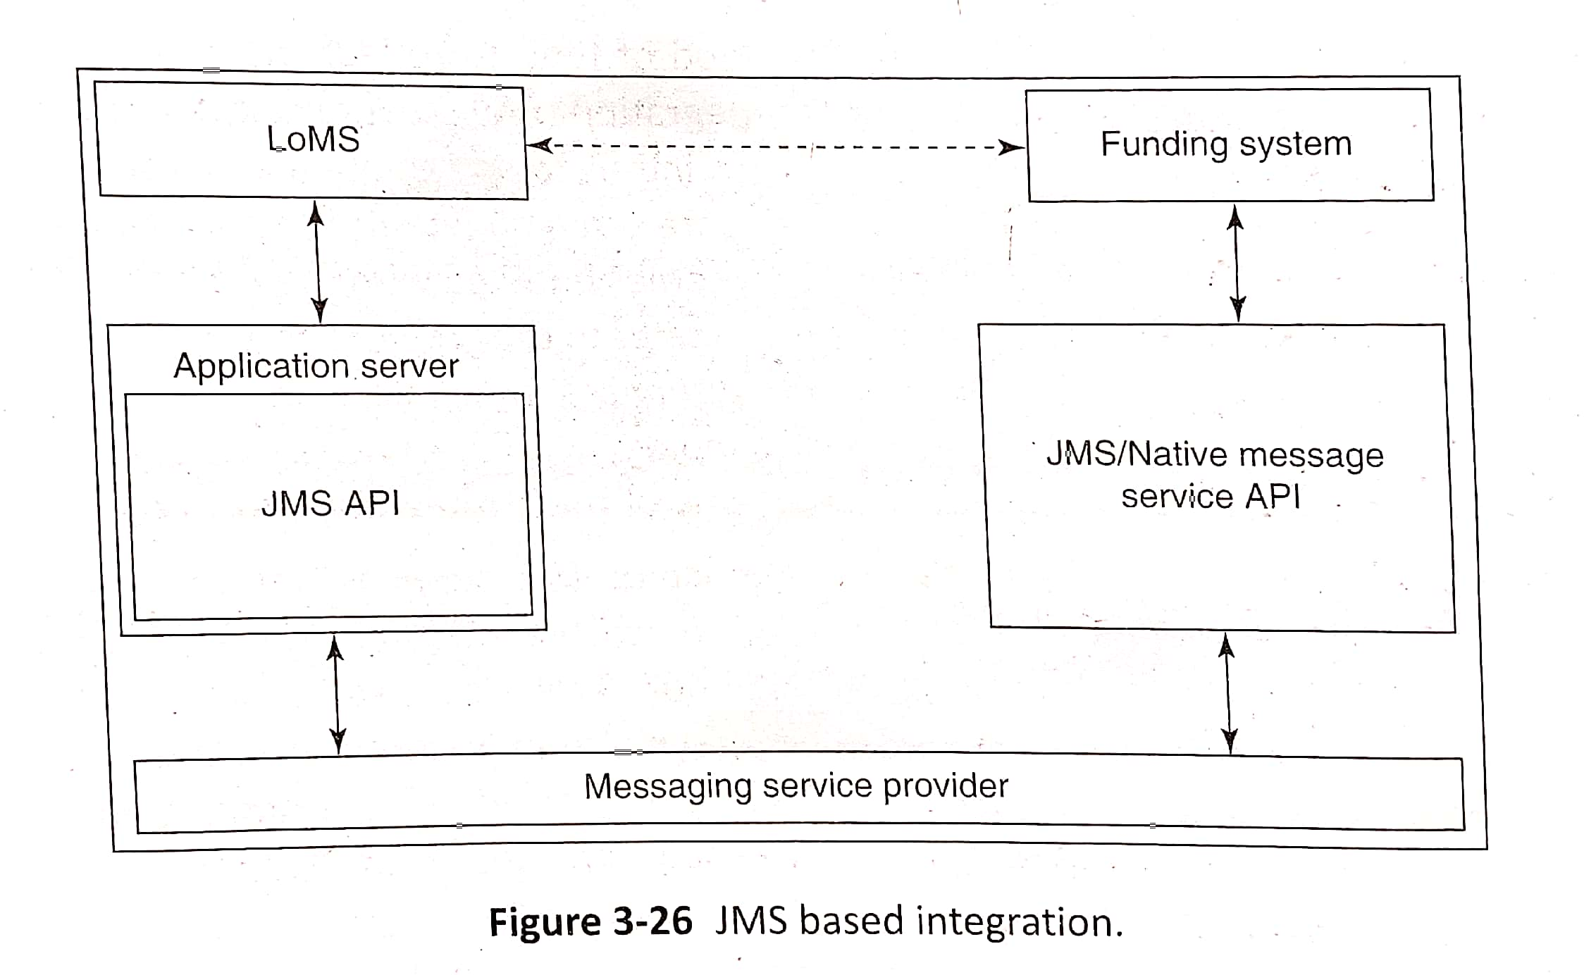
Technical Architecture (contd..)
Integration Layer
Evolution of Integration Layer Technologies
2. Java based application integration
Below diagram shows how JMS is used for communication between Loan Management System (LoMS) and Funding system
JMS based integration

Slide 69
Technical Architecture (contd..)
Integration Layer
Evolution of Integration Layer Technologies
3. Web services
Web service is defined as software system designed to support interoperable machine-to-machine interaction over a network
These web services provide access to business functionality exposed over the internet
Two types of Web services
1. SOAP based Web services
2. REST Web services

Slide 70
Technical Architecture (contd..)
Integration Layer
Evolution of Integration Layer Technologies
3. Web services
SOAP vs REST based Web services
SOAP based Web services | REST based Web Services
Simple Object Access Protocol | Representational State Transfer
SOAP is a protocol | REST is an architecture style
SOAP is a protocol for communication between applications | REST is an architecture style for designing communication interfaces
SOAP is independent and can work with any transport protocol | REST works only with HTTPS
SOAP permits XML data format only | REST permits different data format such as Plain text, HTML, XML, JSON etc.
SOAP messages are larger, which makes communication slower | REST has faster performance due to smaller messages and caching support
SOAP is less preferred than REST | REST more preferred than SOAP
SOAP defines standards to be strictly followed | REST does not define too much standards like SOAP

Slide 71
Technical Architecture (contd..)
Integration Layer
Evolution of Integration Layer Technologies
SOAP based Web services
This SOAP based web services is a collection of technologies/standards/protocols used to define, discover, bind and implement web services
It contains 4 building blocks
1. Service Description
2. Service Messaging Framework
3. Service Transport
4. Service Discovery

Slide 72
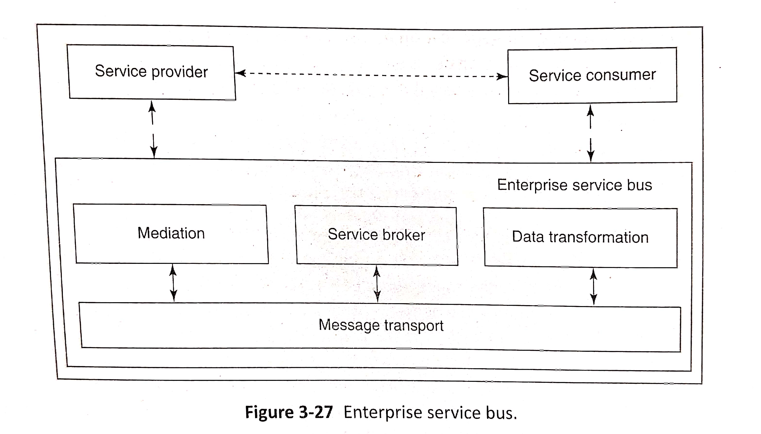
Technical Architecture (contd..)
Integration Layer
Evolution of Integration Layer Technologies
4. Enterprise service bus – service oriented architecture
SOA deals with services as components from which more complex services or applications can be composed
Enterprise Service Bus (ESB) – provides a way for service-oriented integration through which services can be exposed and consumed

Slide 73
Technical Architecture (contd..)
Integration Layer
Design Aspects of Integration Layer
Communication Triggers
- Communication between enterprise application and external
system is done be external triggers. Triggers can be time or
event based triggers
2. Communication methods
2 types,
1. Synchronous - Immediate response for a request
2. Asynchronous - Does not require immediate response. User is
notified when response is received

Slide 74
Technical Architecture (contd..)
Integration Layer
Design Aspects of Integration Layer
Synchronous vs Asynchronous Communication
Synchronous Communication | Asynchronous Communication
When a message or request is sent, there’s an immediate response. | Replies can be delayed
Communicating parties are online at the same time | Communicating parties need not in online at the same time
Synchronous transmission is fast. | Asynchronous transmission is slow
Example: video conferencing, instant messaging, and telephone conversations. | Example: Emails
Java provides Remote Method Invocation (RMI)for synchronous communication | In Java asynchronous communication is done using JMS together with IBM MQ series

Slide 75
Technical Architecture (contd..)
Integration Layer
Design Aspects of Integration Layer
3. Interface contract
- Interface contract helps to have a stable view of services that are
exposed by the application and how to access it
4. Error Handling
- Robust error handling mechanism is needed
5. Integration Topologies
- 3 types of topologies during application integration
1. Point-to-point Topology:
- Direct connection between two systems.
- Feasible if only few systems are involved
2. Message Broker Topology:
- All systems are connected to central broker.
- This topology is also called Hub-and-spoke topology. No
limitation on number of system that can communicate
3. Message Bus Topology
- It is a variation of Message Broker topology where
standards are followed for data formats and protocols are used for communications

Slide 76
Data Architecture
Managing and controlling data is the tedious task for the enterprise
Data Architecture is used to create data models for business
Identification of data, data modeling, life cycle management of data and data security are the primary building blocks of data architecture
Data modeling is the important step in data architecture

Slide 77
Data Architecture (contd..)
Data Modeling
1.Relational Data Modeling
Usually relational databases are used for storing the data
These databases are modeled using a relational data model
Relational data modeling uses three-step approach
1. Conceptual modeling
- This is the first step which is used to model the real-world
business entities and the relationship between them
- This modeling is done in requirements phase
2. Logical modeling
- In this modeling conceptual data model is transformed into logical
implementation
- It consists of relations (tables), attributes and relationships among
entities
- This modeling is done in design phase. E-R diagrams are used for
logical modeling

Slide 78
Data Architecture (contd..)
1.Relational Data Modeling
3. Physical modeling
- In this last step logical model is transformed to physical model
- This step involves the physical creation of tables, views and
indexes
- Creation of physical model happens in the construction phase

Slide 79
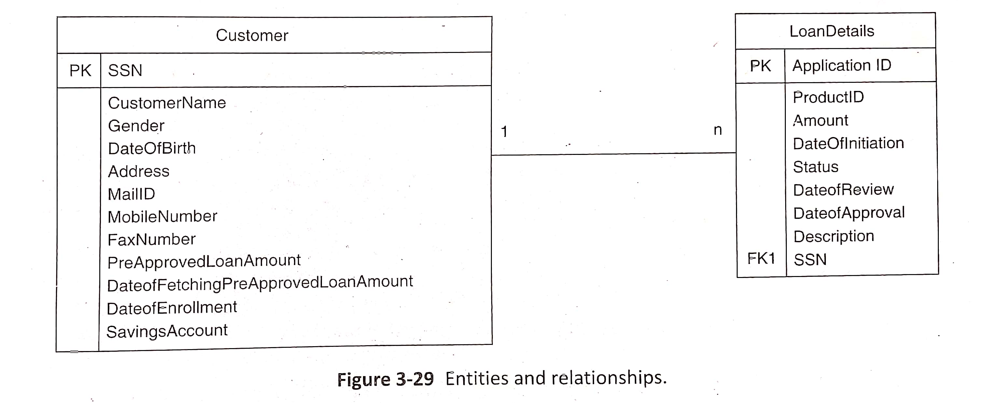
Data Architecture (contd..)
1. Relational Data Modeling
E-R Diagram
Logical modeling is done with the help of E-R diagrams
E- R diagram consists of Entity set, attributes for every entity and relationship between them
Relationship can be one-to-one, one-to-many or many-to-many
Primary Key and Foreign key can be specified in the E-R diagrams

Slide 80
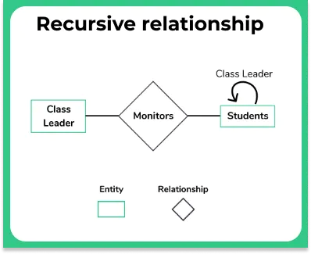
Data Architecture (contd..)
1. Relational Data Modeling
E-R Diagrams
Different Variations of Relationships
Recursive Relationship
Relationship among entities(rows) of the same table is called recursive relationship
Example:
1. In a student table, a student who is a class leader for another student
2. In a Bank employee table, a employee whose is a manger for
another employee

Slide 81
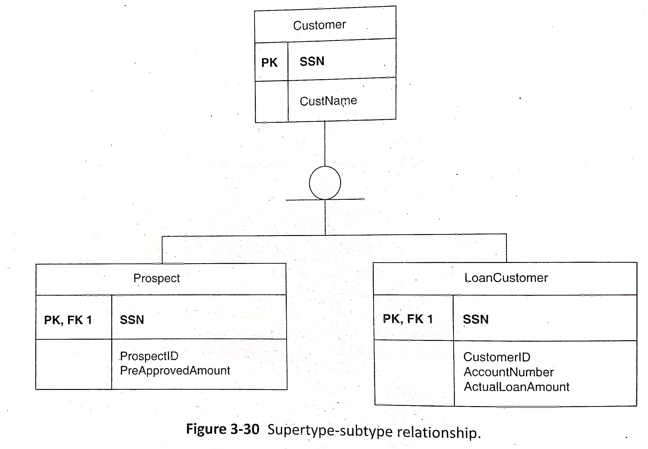
Data Architecture (contd..)
1. Relational Data Modeling
E-R Diagrams
Different Variations of Relationships
b. Supertype-subtype Relationship
This relationship is similar to Generalization relationship
Customer can be Prospect customer or Loan customer. Customer is the Supertype and Prospect customer and Loan Customer are the subtype

Slide 82
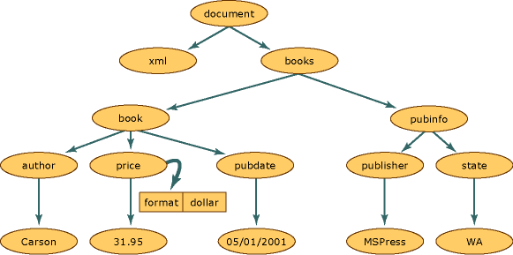
Data Architecture (contd..)
2. XML Data Modeling
XML is an extensible and structured markup language which describes data in a plain text format
XML represents information in a hierarchical fashion so in XML modeling also done in hierarchical nature. XMLSpy is one of the XML modeling tool
There is an XML Schema Definition(XSD) document which contains the grammar for the data stored in the XML document
XML Parsers APIs like Simple API for XML(SAX), Document Object Model(DOM), Streaming API for XML (StAX) are used to parse and read/write data from/to XML documents

Slide 83
Data Architecture (contd..)
3. Other Structured Data Representations
Apart from relational and XML we can have other representations like directories and object-oriented databases
The data that resides in hierarchical data stores in the directory servers are called directory data
Example of Directory data is the DNS servers which maps host names to the IP address
Sun Java Directory Server and Microsoft Active Directory Server are the directory server products that are available
Data can also be stored in object-oriented databases
Databases from some vendors support object-oriented data storage

Slide 84
Data Architecture (contd..)
4. Unstructured Data Representations
The structure of the data stored in documents do not follow any standard representation which are called as unstructured data
Unstructured data are represented as stream of binary or text data
Data stored in flat files, text documents, PDFs, images ,sounds and videos are examples of unstructured data
Oracle provides BLOB(Binary Large Object) to store binary data in relational tables

